Slide 1
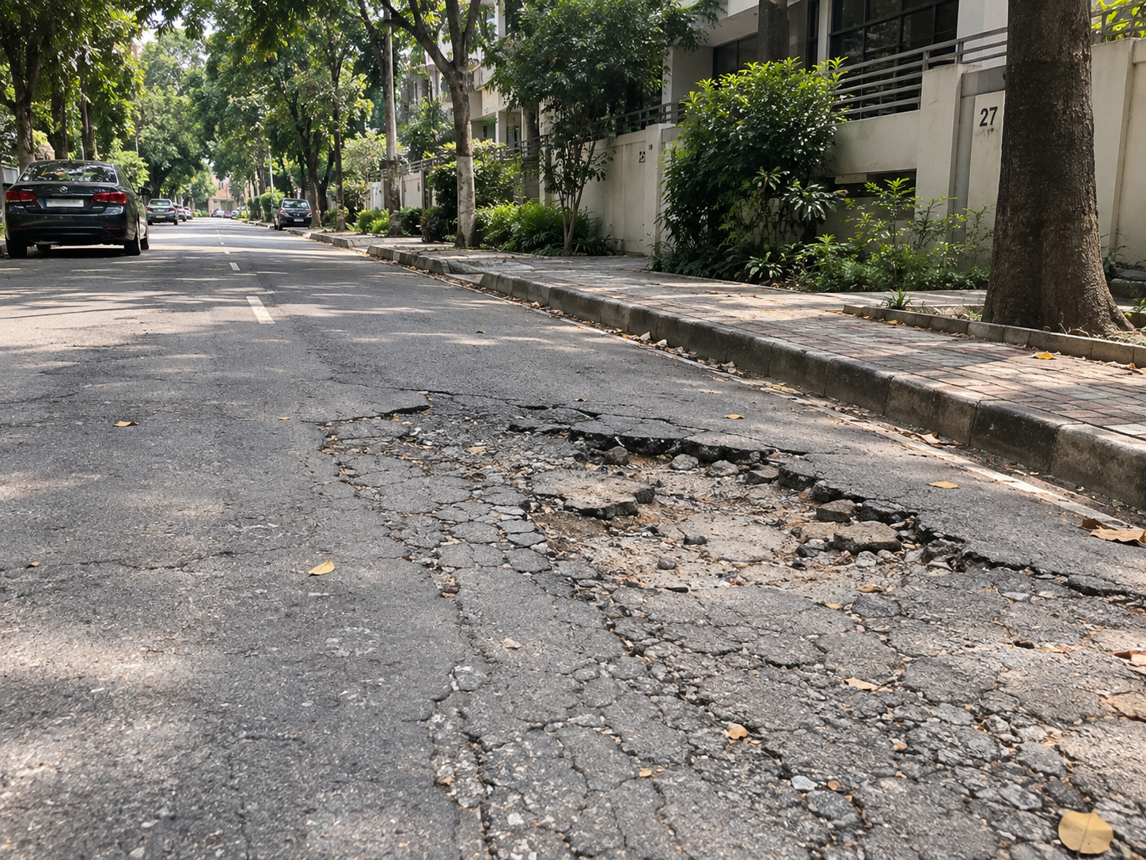
1
INTRODUCTION · WHY THIS PLATFORM
Problem Statement
Overview
Community maintenance complaints remain fragmented and difficult to track
1
Residents rely on phone calls, social media groups, and informal messages.
2
Reports often arrive without structured evidence or accurate location details.
3
Duplicate reports and disconnected channels delay verification and assignment.
4
Residents have limited visibility into progress, reducing trust and accountability.
Nogor Shomadhan provides one verified workflow from reporting to resolution.
THE EVERYDAY REALITY
Visible to everyone, yet no record of who reported it or what happens next.
Nogor Shomadhan · User Manual
1 / 27

Slide 2
2
INTRODUCTION · WHO USES THE PLATFORM
Stakeholders and Responsibilities
Three roles
Resident
Admin
Community Authority
Reports community problems with location and optional photographic evidence.
Tracks complaint status and receives important notifications.
Participates through urgency votes, forum discussions, and feedback.
Verifies resident accounts and newly submitted complaints.
Reviews possible duplicates identified by the system.
Approves valid records and maintains platform integrity.
Reviews verified complaints and begins the required work.
Manages deadlines, budgets, contractors, notes, and evidence.
Resolves complaints and responds to resident feedback.
System and AI: categorization, duplicate screening, status tracking, and notifications
SUPPORTING LAYER
Nogor Shomadhan · User Manual
2 / 27

Slide 3
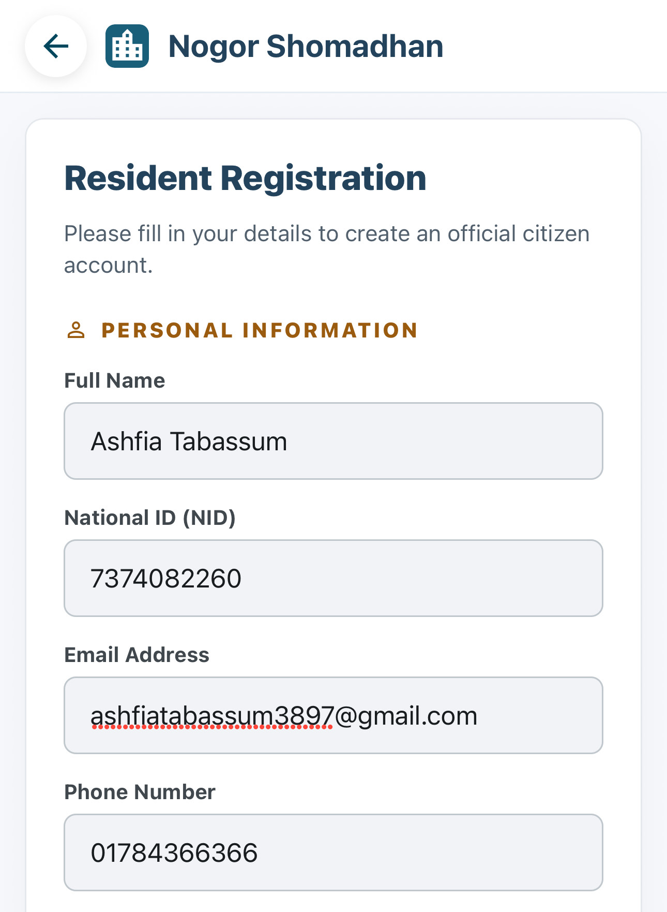
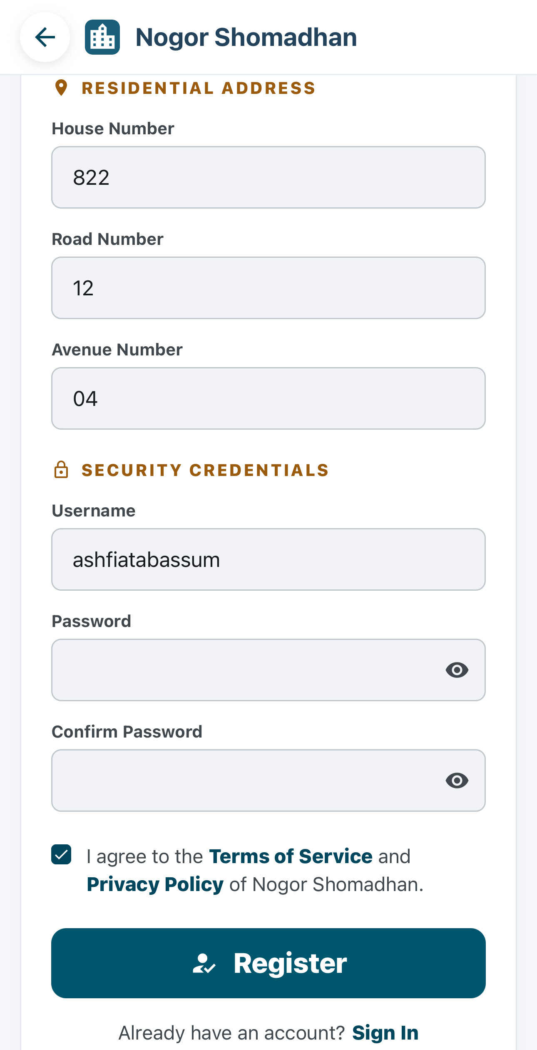
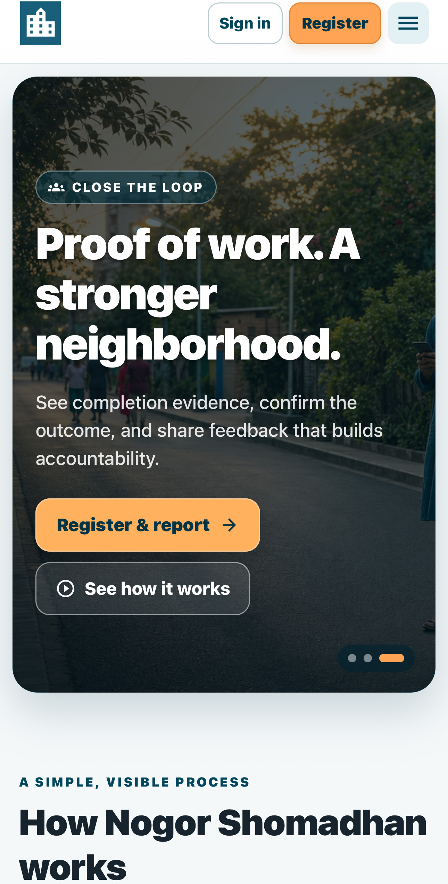
3
PHASE 1 · ACCOUNT REGISTRATION AND VERIFICATION
Resident Account Registration
Resident
2
3
1
Open Register from the public home page.
1
2
Enter identity and contact information.
3
Add the residential address and secure login credentials.
4
Review the information before registration.
4
Personal details masked for this presentation.
Public home page
Personal information
Address and credentials
Nogor Shomadhan · User Manual
3 / 27

Slide 4
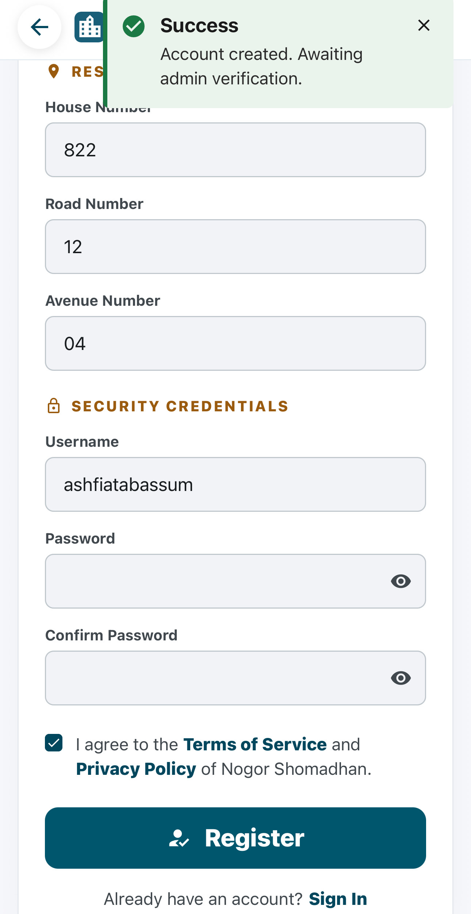
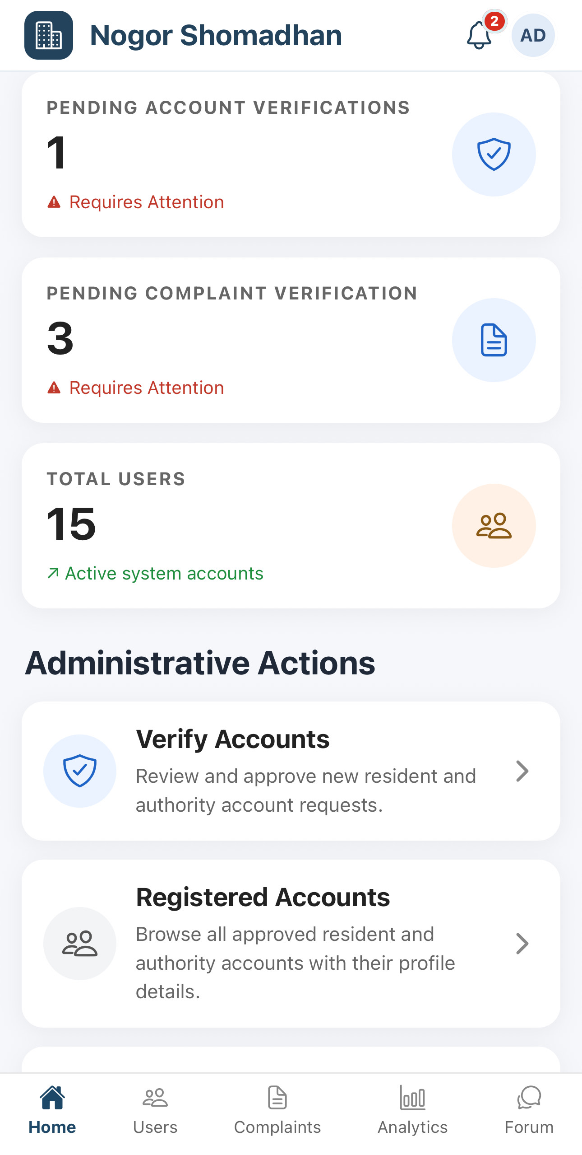
4
PHASE 1 · ACCOUNT REGISTRATION AND VERIFICATION
Registration Request Submitted
Resident
Admin
RESIDENT
ADMIN
1
The resident submits the completed registration form.
3
4
2
The system creates the account with an unverified status.
HANDS OVER TO
3
The resident sees an awaiting-verification confirmation.
4
The admin dashboard displays a new pending account.
Nogor Shomadhan · User Manual
4 / 27

Slide 5
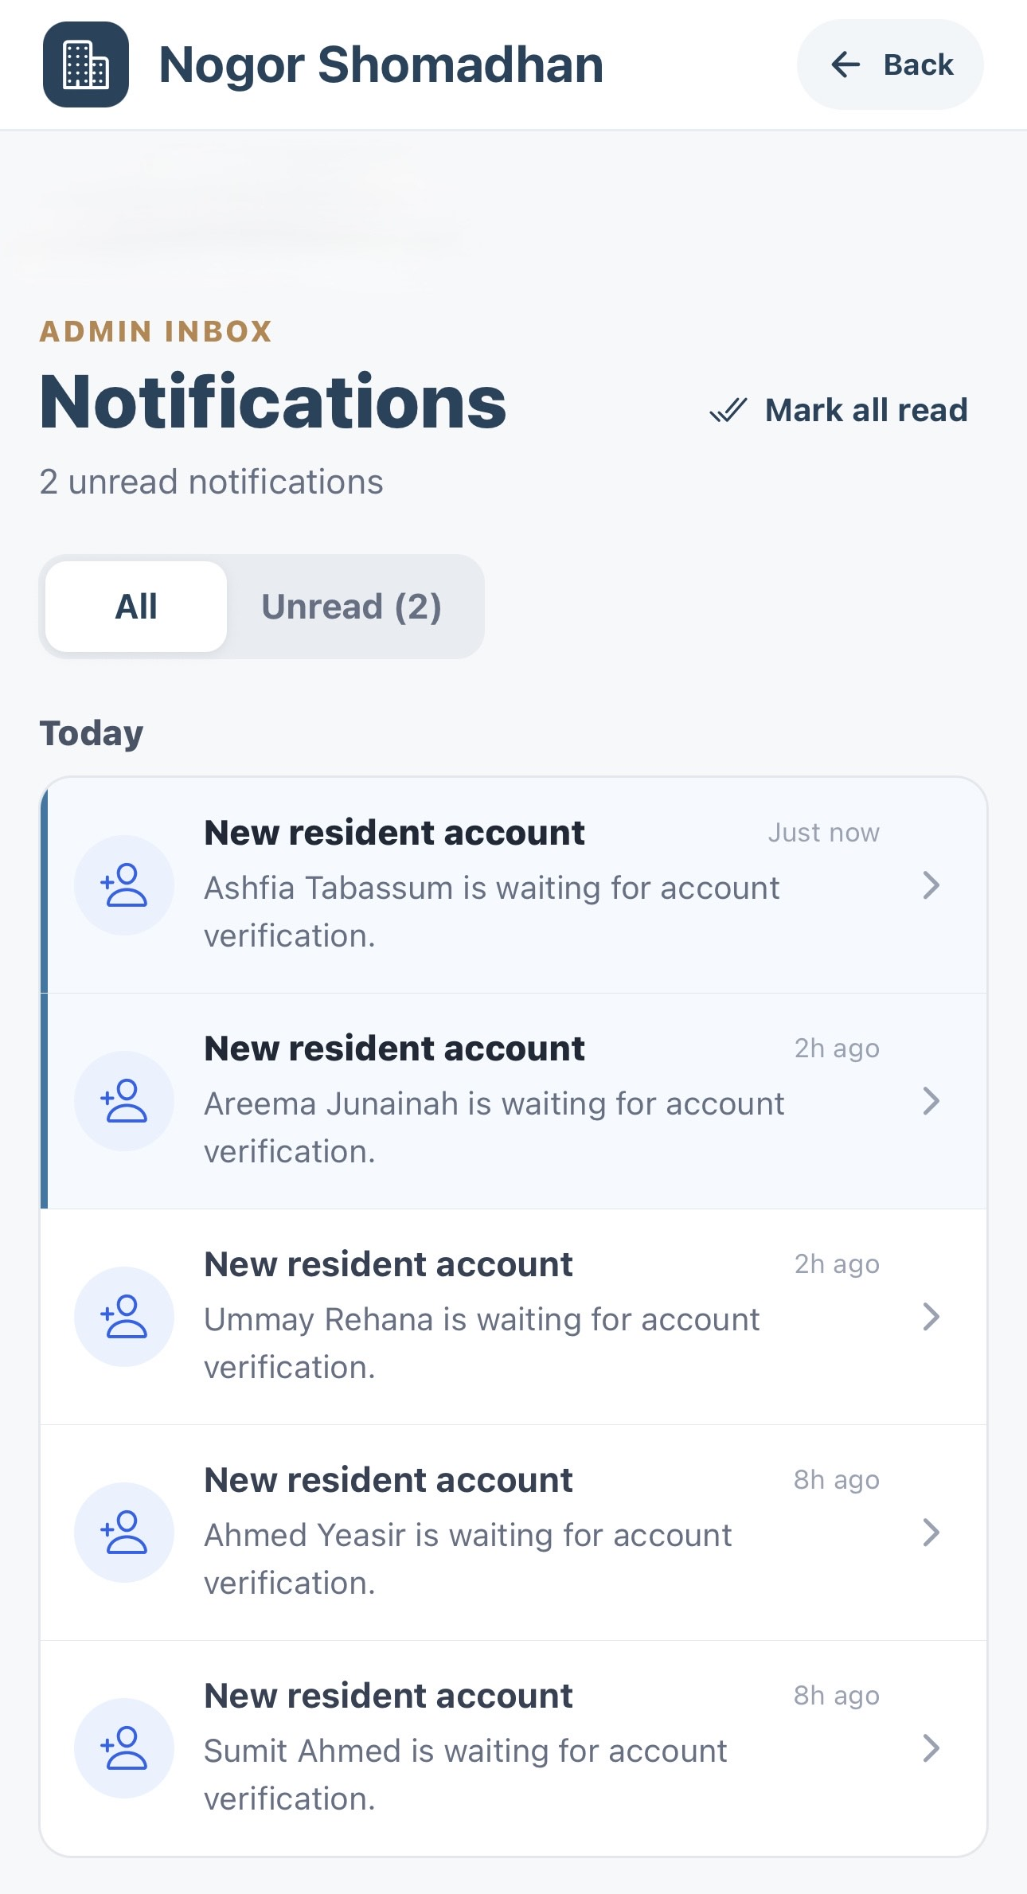
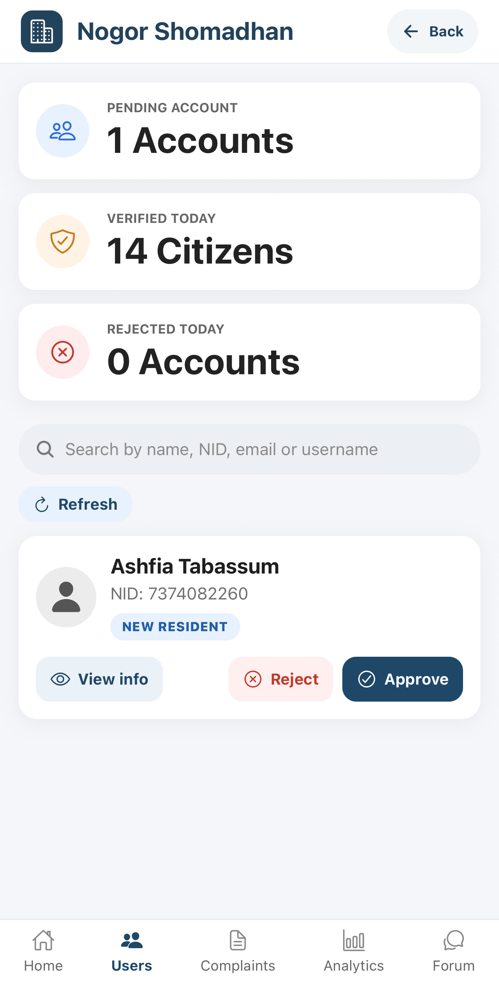
5
PHASE 1 · ACCOUNT REGISTRATION AND VERIFICATION
Admin Receives the Verification Request
Admin
1
The admin receives a new resident account notification.
2
Selecting the notification opens Pending Accounts.
2
1
opens
3
3
The new resident appears in the verification queue.
4
4
The admin can review, approve, or reject the request.
Personal details masked for this presentation.
Admin notification inbox
Pending account verifications
Nogor Shomadhan · User Manual
5 / 27

Slide 6
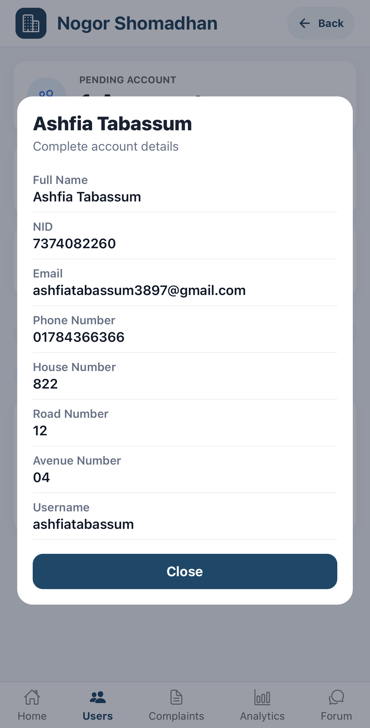
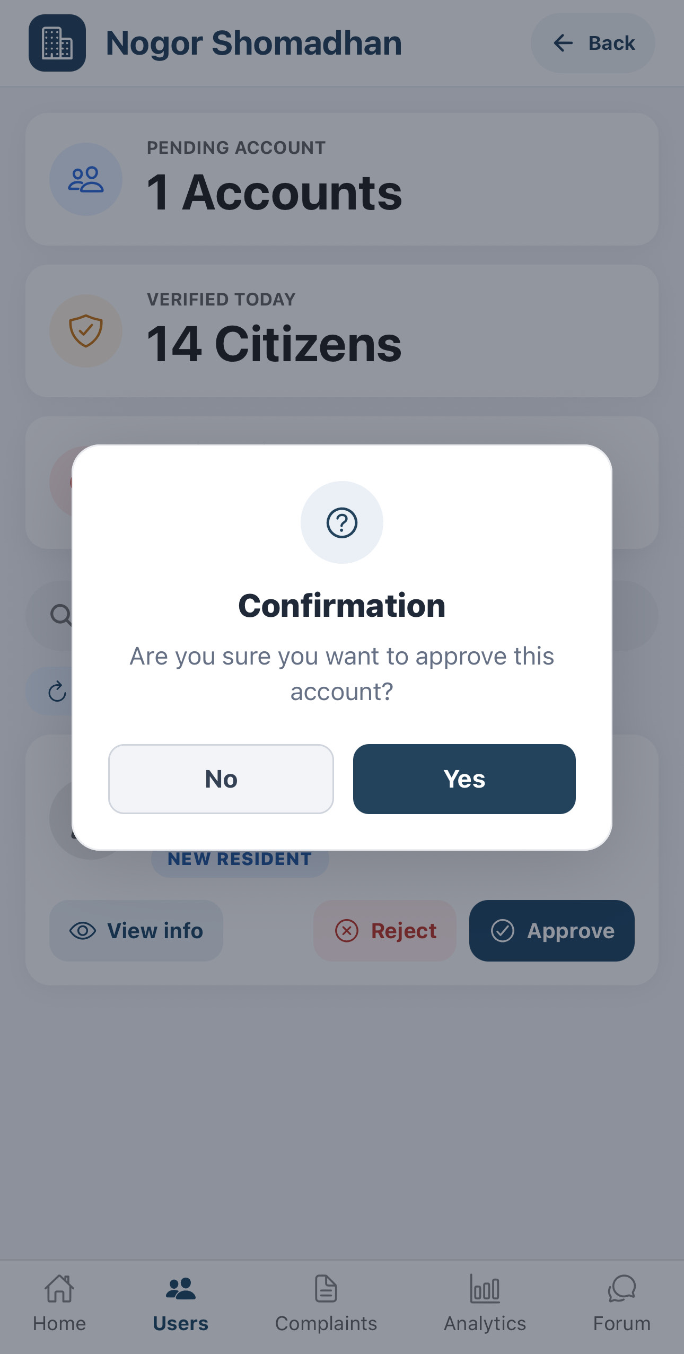
6
PHASE 1 · ACCOUNT REGISTRATION AND VERIFICATION
Admin Reviews and Approves the Account
Admin
1
Review the resident’s submitted account information.
1
2
Confirm that the identity and address details are valid.
2
4
3
Select Approve for a valid registration.
3
4
Confirm the approval action.
Personal details masked for this presentation.
Complete account details
Approval confirmation
Nogor Shomadhan · User Manual
6 / 27

Slide 7
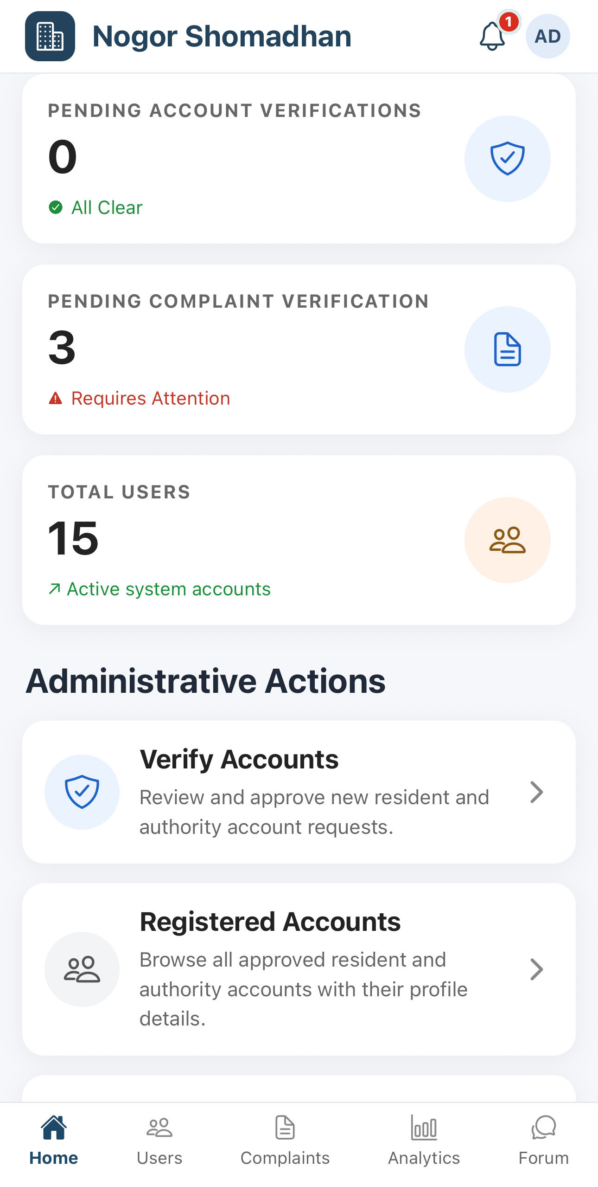
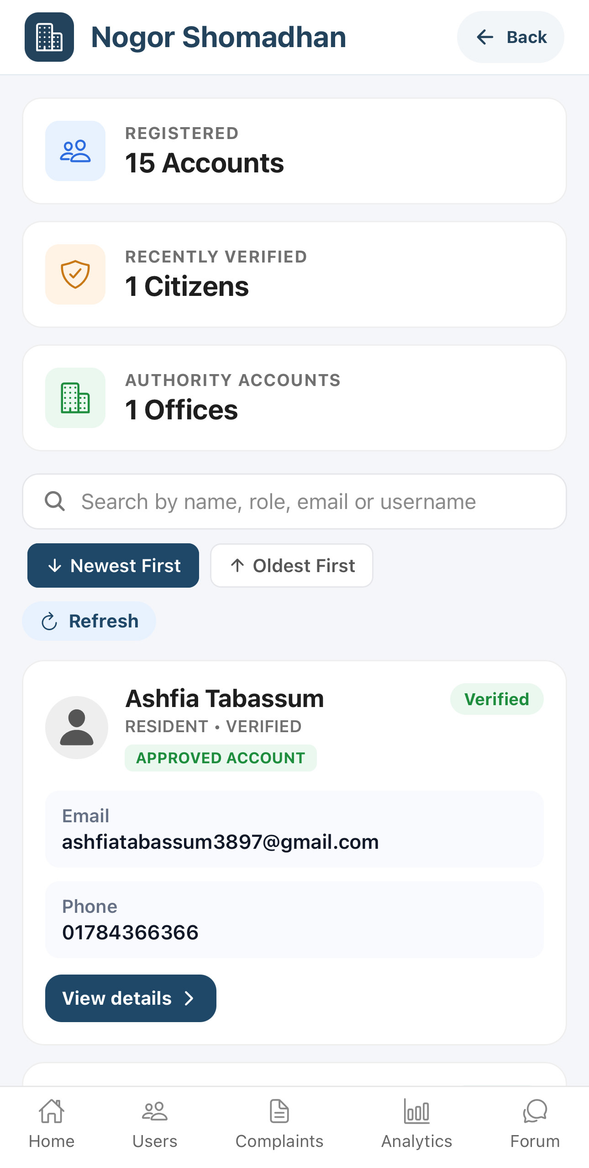
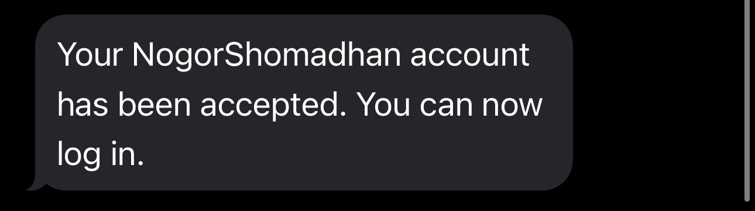
7
PHASE 1 · ACCOUNT REGISTRATION AND VERIFICATION
Account Verification Completed
Resident
Admin
The resident receives an SMS confirming account approval.
Admin dashboard
Registered accounts
1
2
Select Registered Accounts to view all approved profiles.
3
The account appears in the Registered Accounts list.
4
The account status changes to Verified.
3
4
SMS TO THE RESIDENT
2
1
The resident can now sign in and begin reporting community problems.
Nogor Shomadhan · User Manual
7 / 27

Slide 8
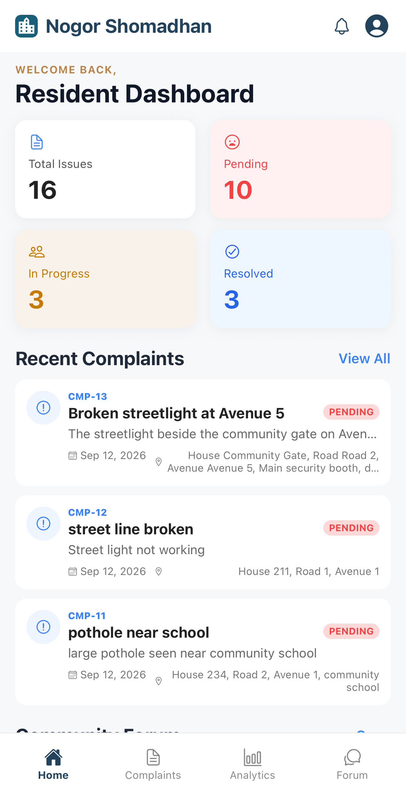
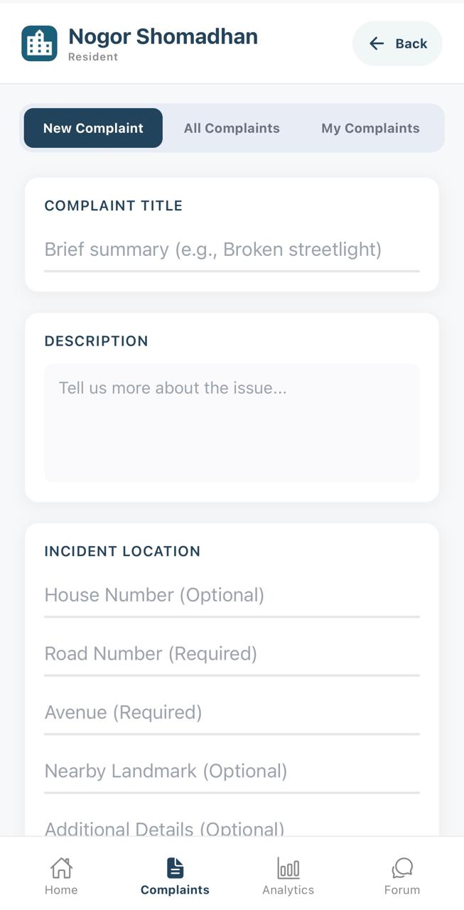
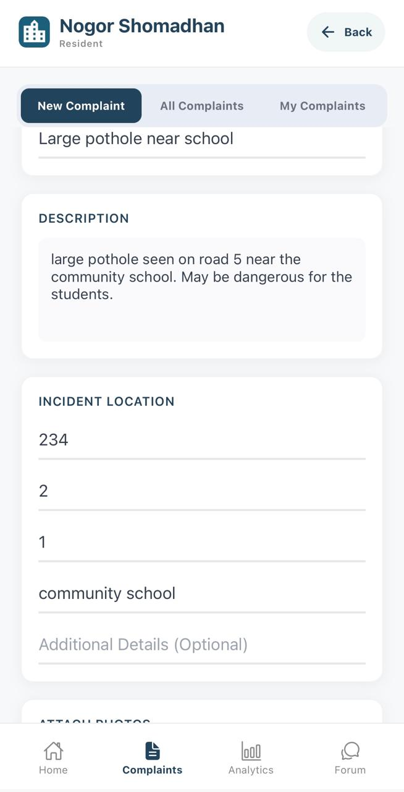
8
PHASE 2 · RESIDENT SUBMITS A COMPLAINT
Create a New Complaint
Resident
The resident opens the complaint form and provides clear information about the community issue and its location.
1
Select Complaints from the Resident Dashboard.
2
2
Open the New Complaint tab.
3
3
Enter the complaint title, description, incident address, nearby landmark, and additional location details.
1
Nogor Shomadhan · User Manual
8 / 27

Slide 9
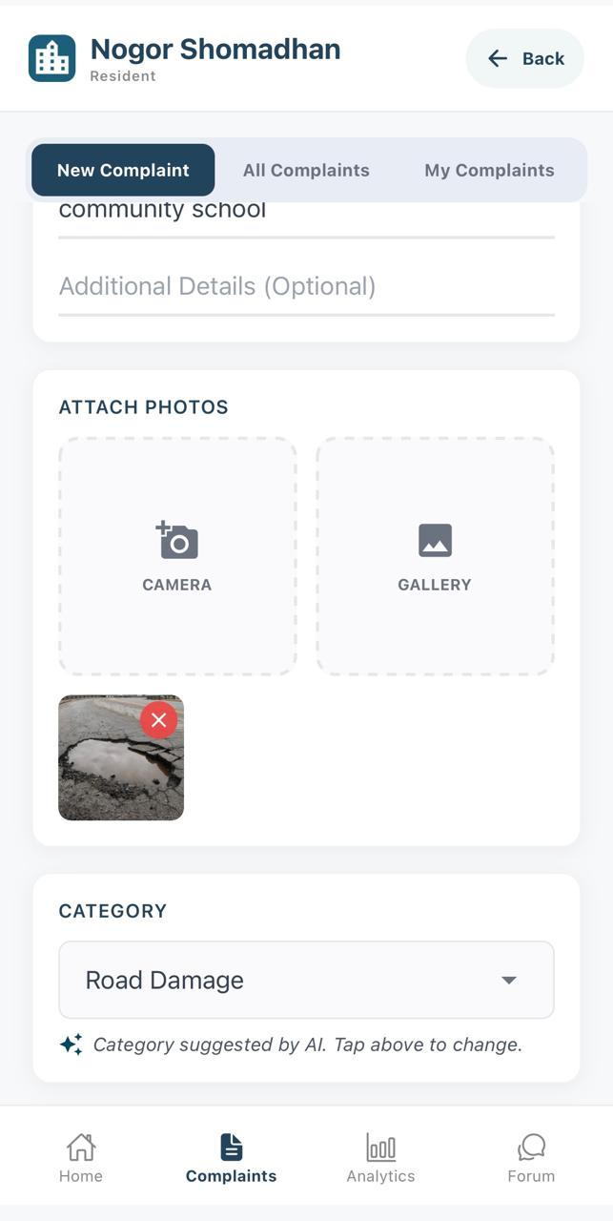
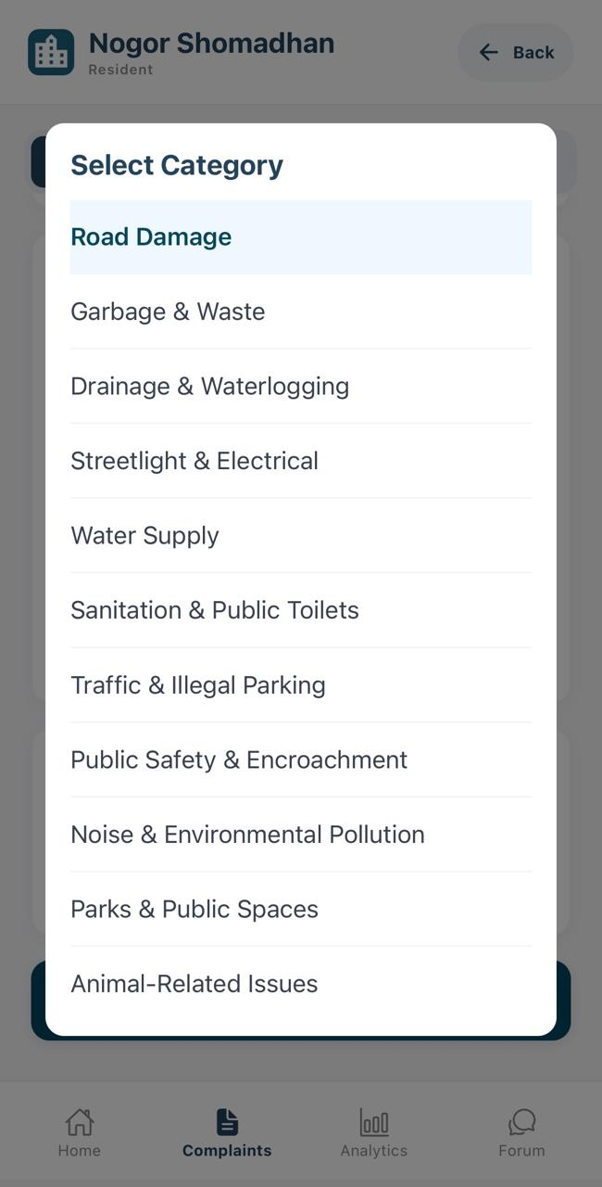
9
PHASE 2 · RESIDENT SUBMITS A COMPLAINT
Add Evidence and Review the Category
Resident
Photo evidence is optional. The system suggests a category from the complaint information, but the resident can change it before submission.
1
Optionally attach photo evidence using the camera or gallery.
3
1
Review the category automatically suggested by the AI.
opens
2
3
If necessary, open the category menu and select a more appropriate category manually.
2
Nogor Shomadhan · User Manual
9 / 27

Slide 10
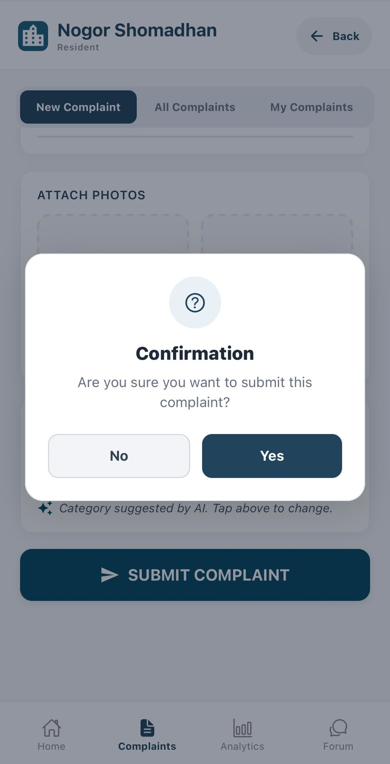
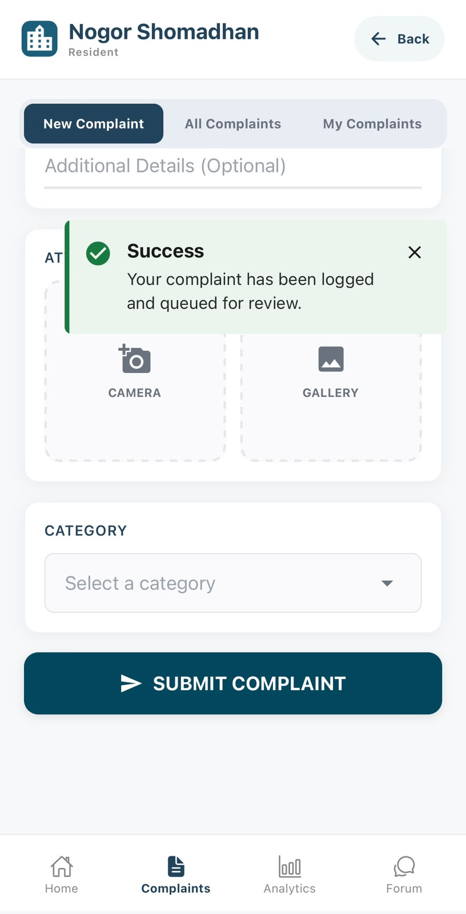
10
PHASE 2 · RESIDENT SUBMITS A COMPLAINT
Confirm the Complaint Submission
Resident
The complaint is submitted successfully and placed in the review queue. Administrative processing continues in Phase 3.
1
Tap Submit Complaint.
2
Review the confirmation prompt and select Yes.
3
3
The success message confirms the complaint was logged and queued for review.
2
NOTE The empty form behind the message is the reset form, ready for the next complaint.
1
Enter Details
Add Optional Evidence
Review Category
Confirm Submission
Nogor Shomadhan · User Manual
10 / 27

Slide 11
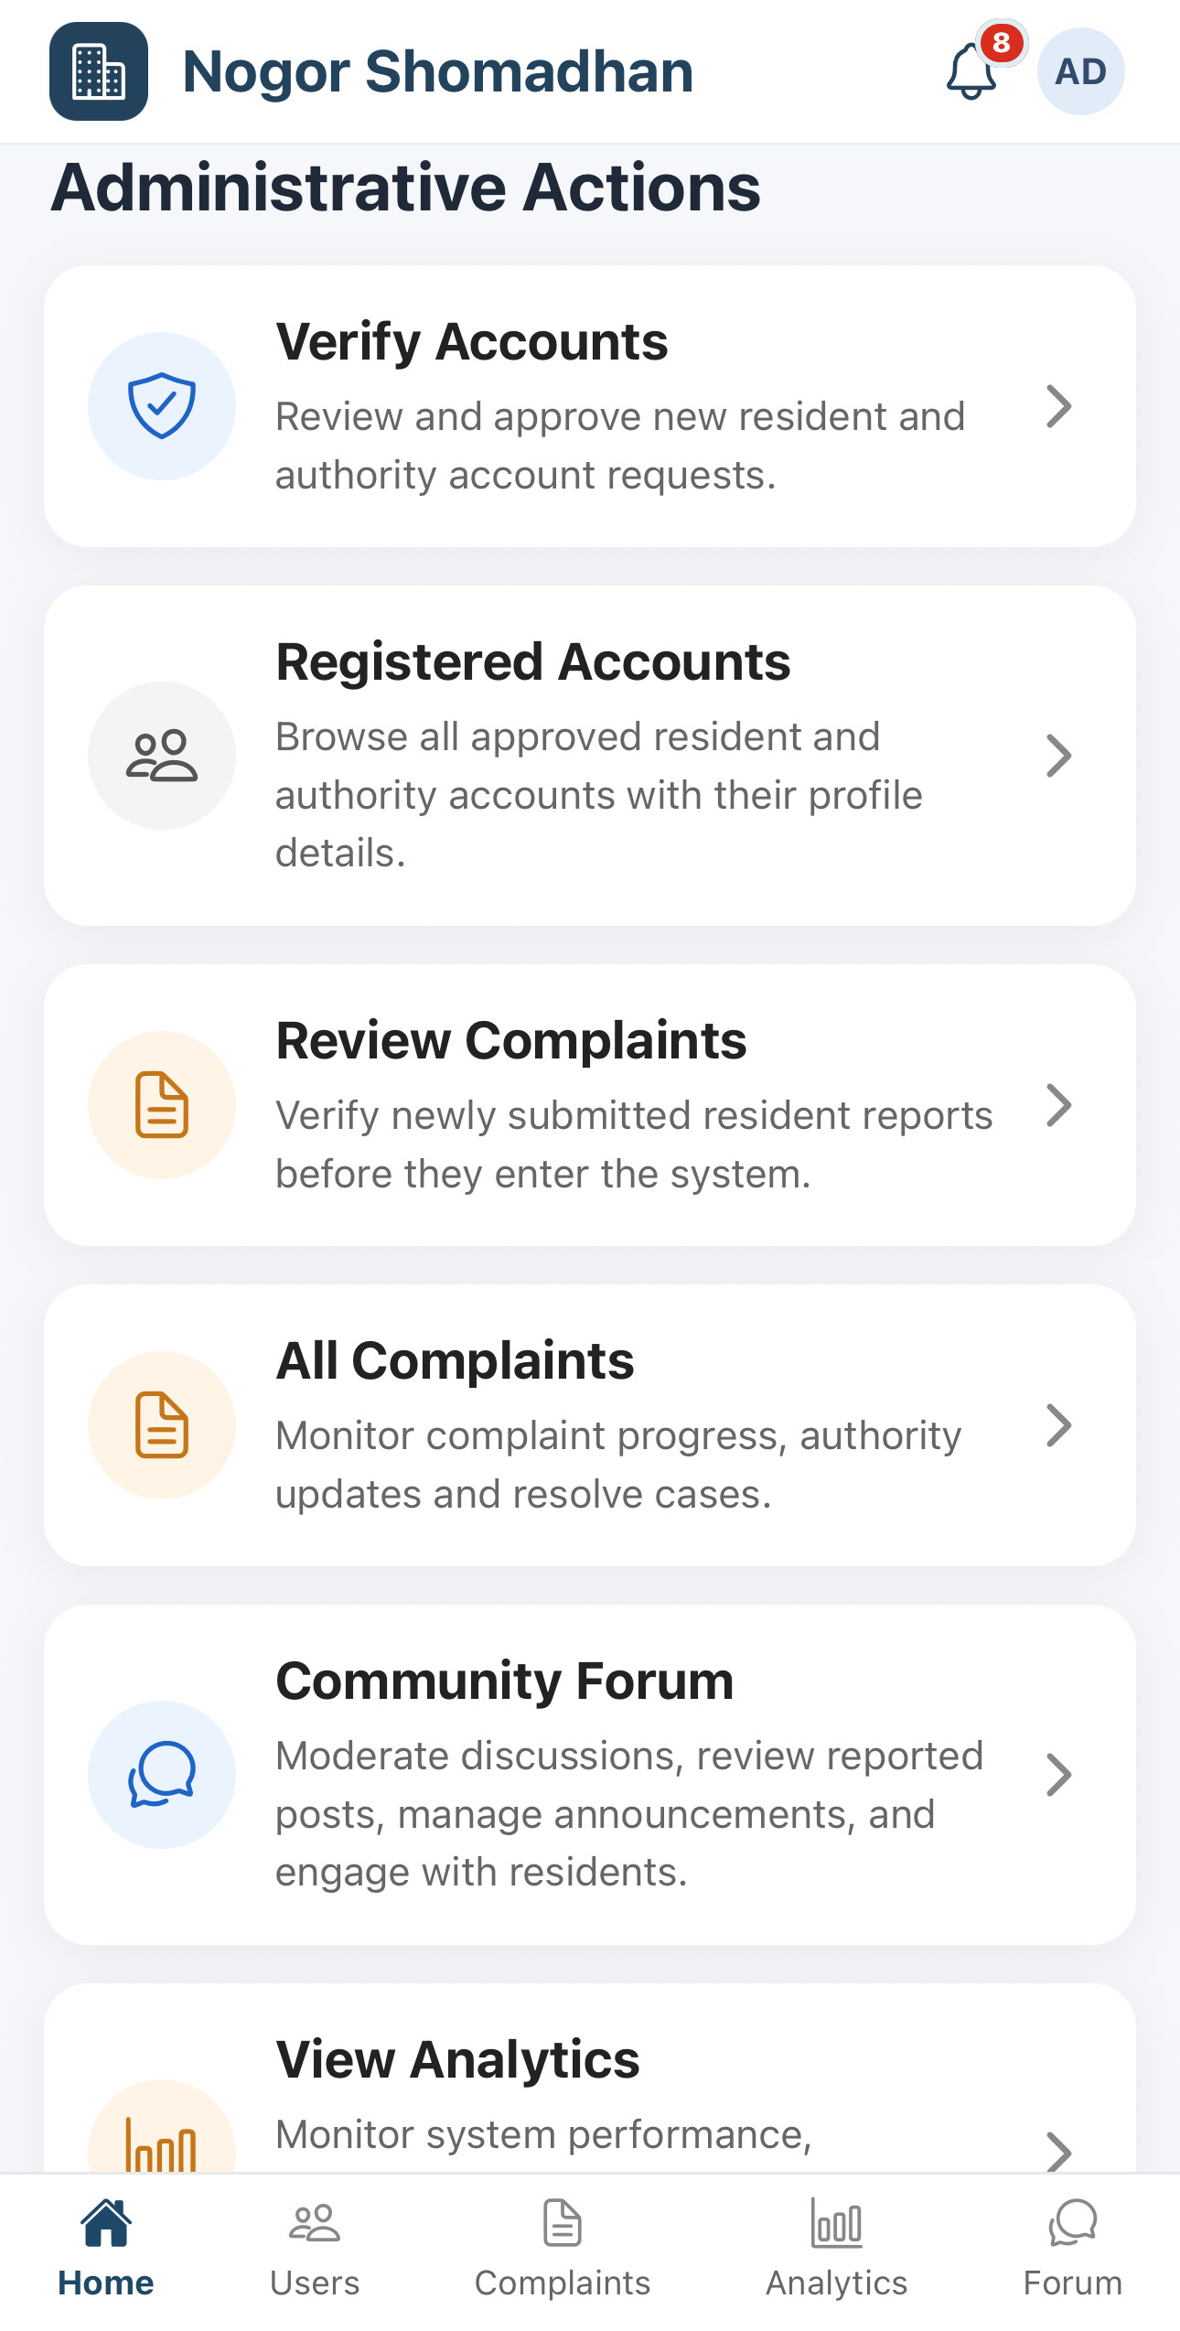
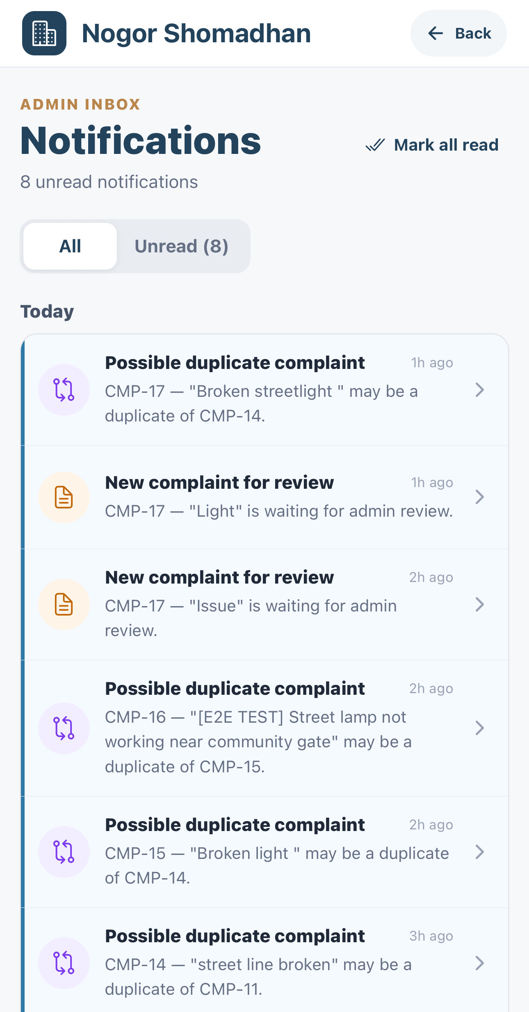
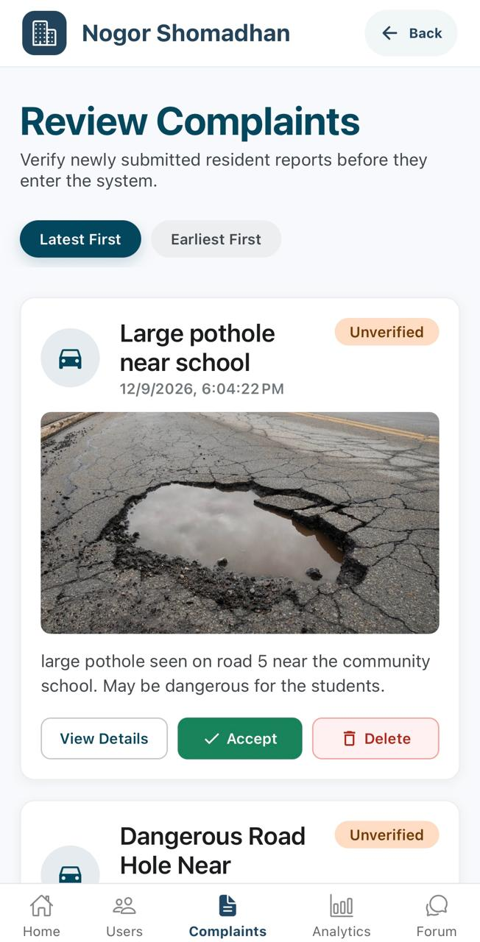
11
PHASE 3 · ADMIN COMPLAINT VERIFICATION
Admin Opens the Review Queue
Admin
1
Dashboard — the admin opens Review Complaints from Administrative Actions.
2
3
Notifications — new complaints and possible duplicates are listed.
1
2
3
Review Queue — the complaint appears with an Unverified status.
Admin dashboard
Admin notifications
Review queue
Nogor Shomadhan · User Manual
11 / 27

Slide 12
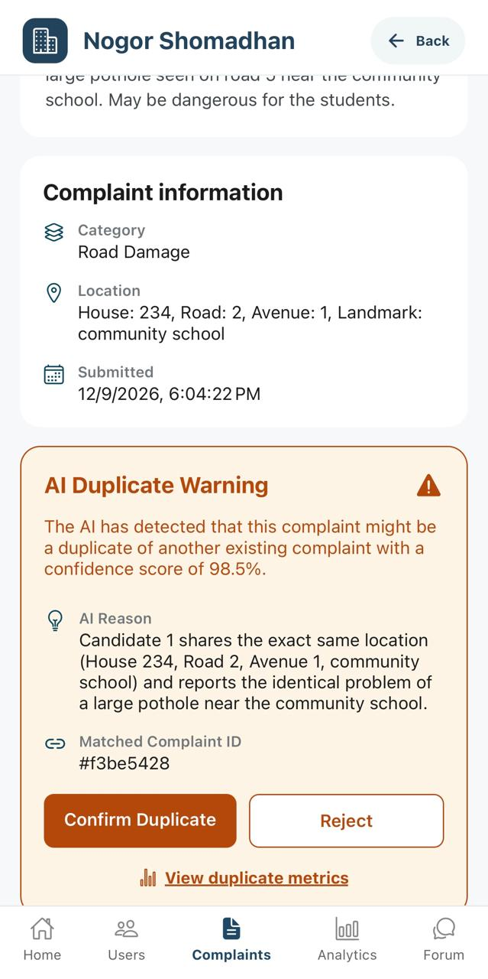
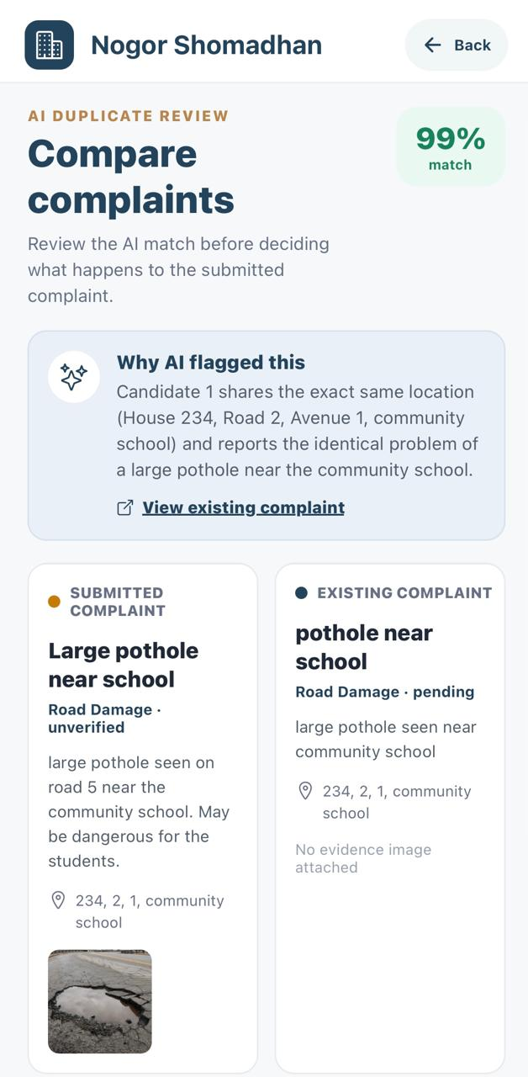
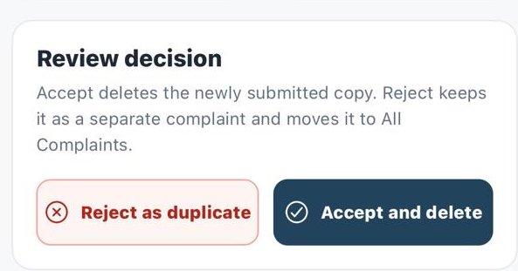
12
PHASE 3 · ADMIN COMPLAINT VERIFICATION
Complaint Check and Duplicate Comparison
Admin
4
Complaint Information — category, location, submitted, evidence.
4
5
AI Duplicate Warning — confidence score, reason, base complaint ID.
6
Review Decision — confirm the duplicate, or reject it.
5
6
Nogor Shomadhan · User Manual
12 / 27

Slide 13
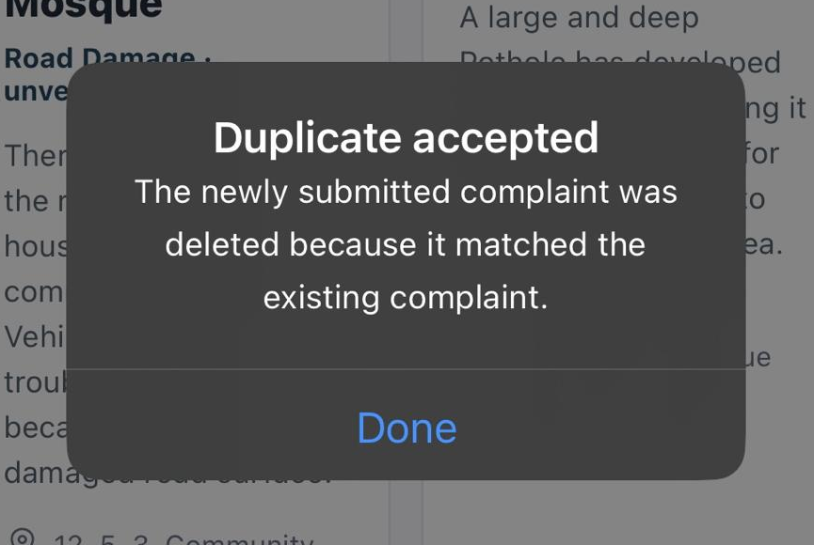
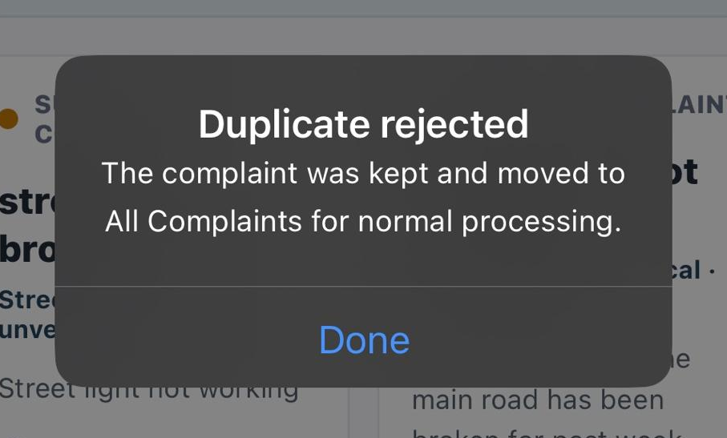
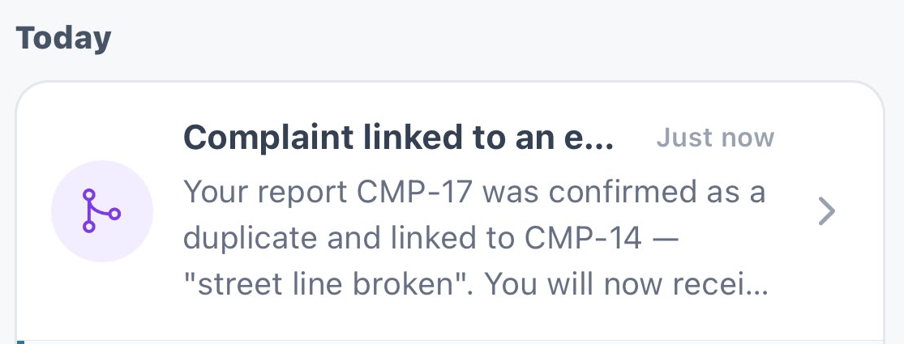
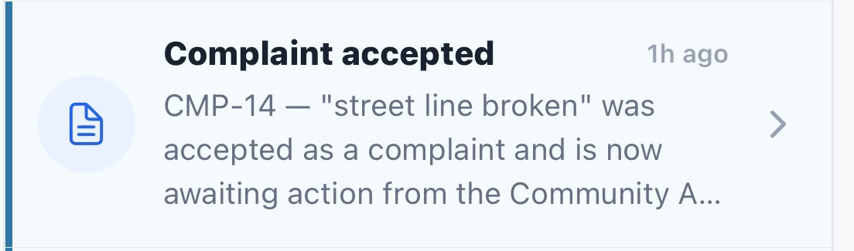
13
PHASE 3 · ADMIN COMPLAINT VERIFICATION
Duplicate Review Outcomes
Admin
Resident
DUPLICATE CONFIRMED
NOT A DUPLICATE
ADMIN DECISION
ADMIN DECISION
The admin confirms the match. The submitted copy is deleted and linked to the base complaint.
The admin rejects the duplicate suggestion, not the complaint. It is kept and set to Pending.
RESIDENT OUTCOME
RESIDENT OUTCOME
The resident is notified with both complaint IDs and follows the base complaint.
The resident is notified that the complaint was accepted and tracks it as Pending.
Nogor Shomadhan · User Manual
13 / 27

Slide 14
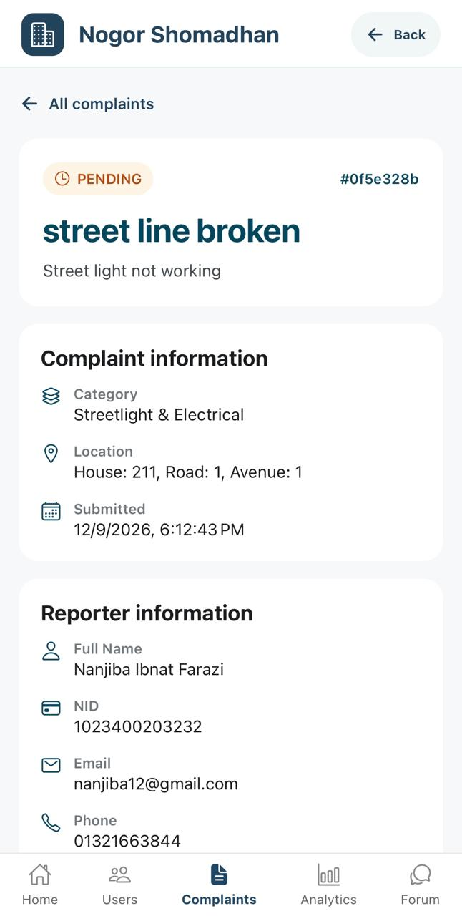
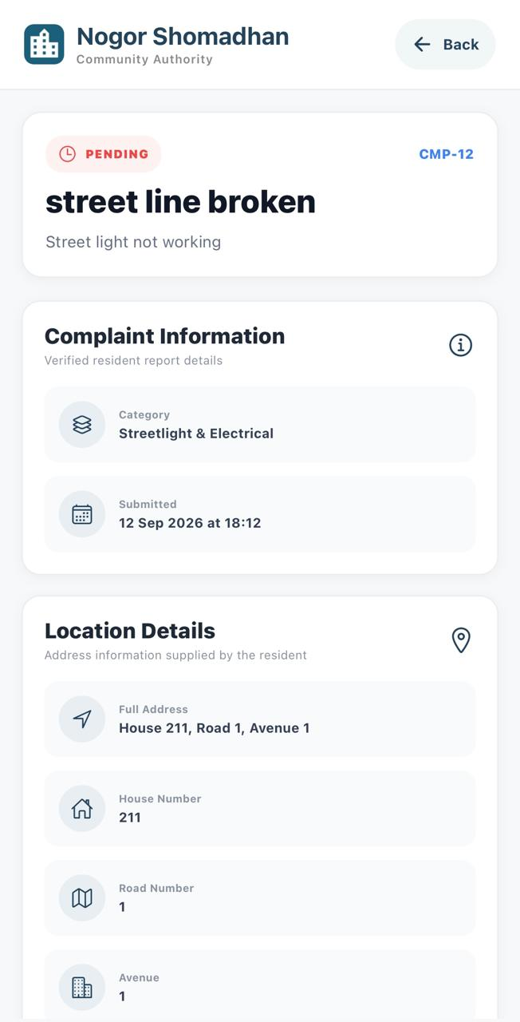
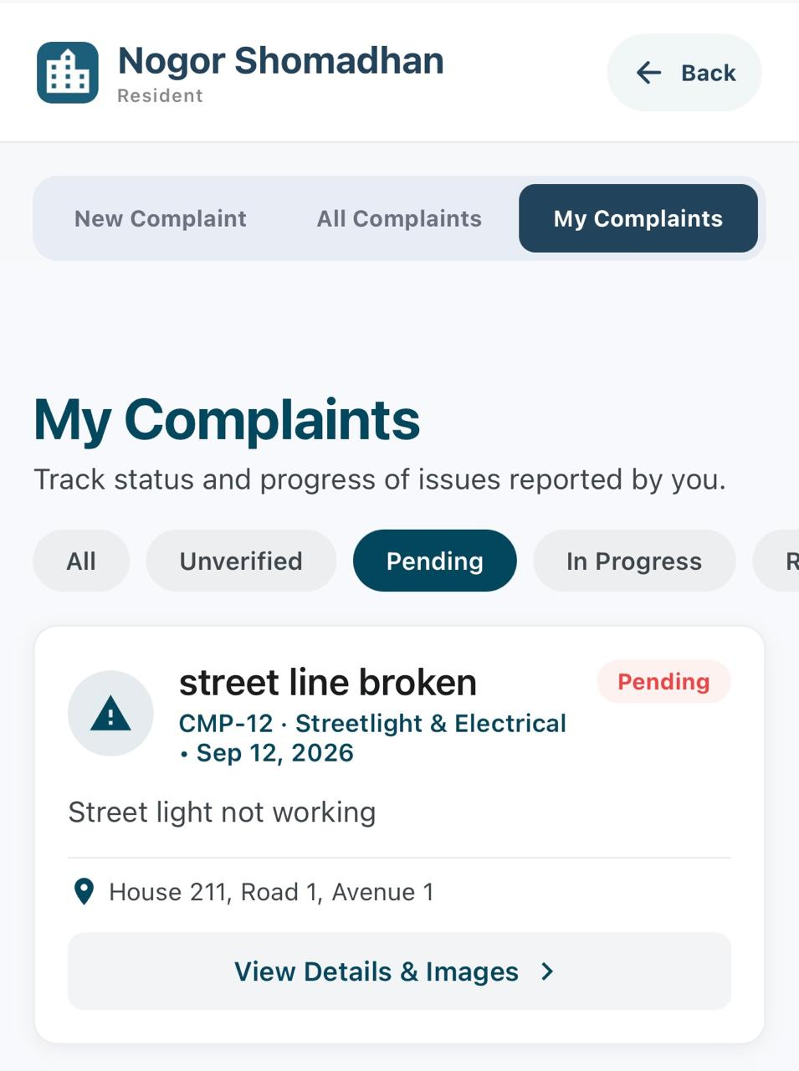
14
PHASE 3 · ADMIN COMPLAINT VERIFICATION
Pending Complaint Visibility
Not a duplicate
ADMIN
COMMUNITY AUTHORITY
RESIDENT
Appears in All Complaints with Pending status.
Available to the assigned authority for mitigation.
Visible in My Complaints with status and progress.
A complaint that is not a duplicate continues as a separate Pending complaint and becomes visible to every relevant role.
Nogor Shomadhan · User Manual
14 / 27

Slide 15
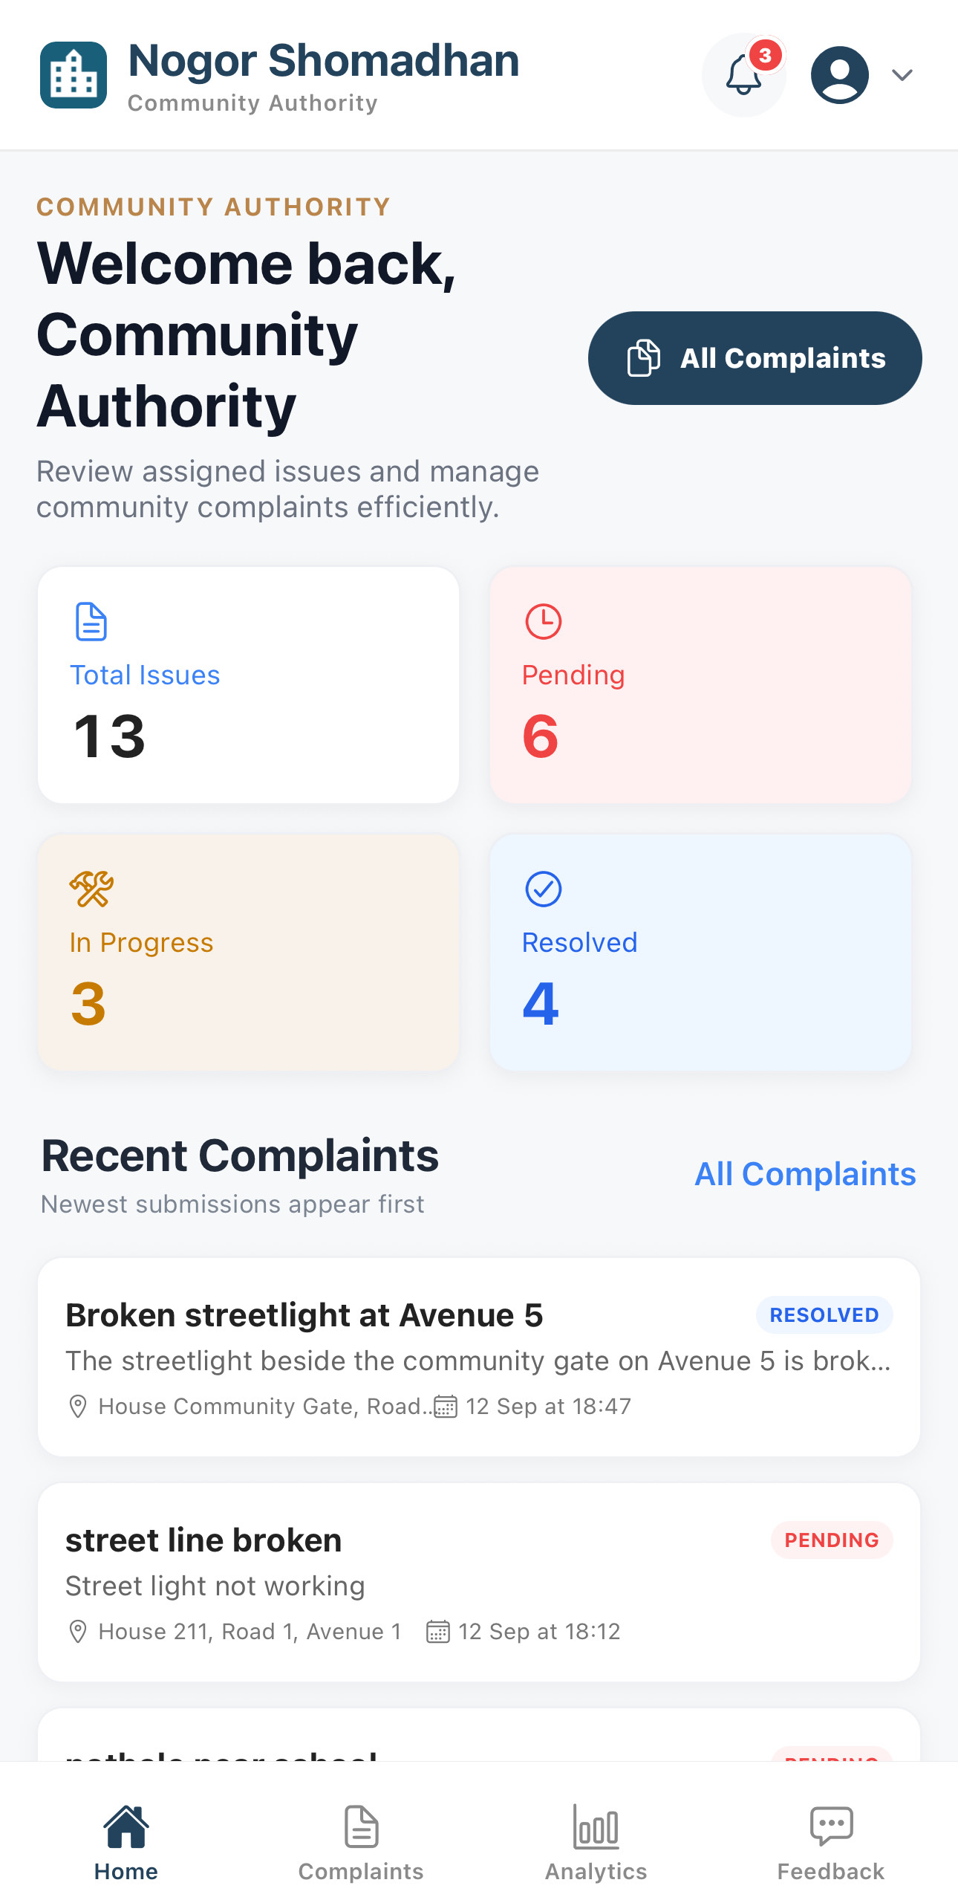
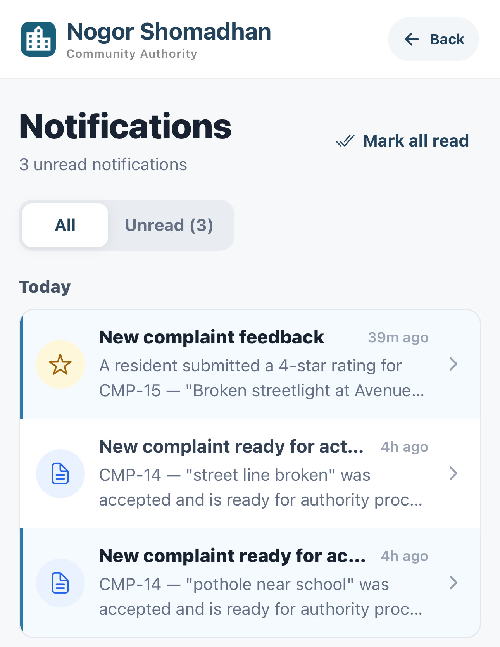
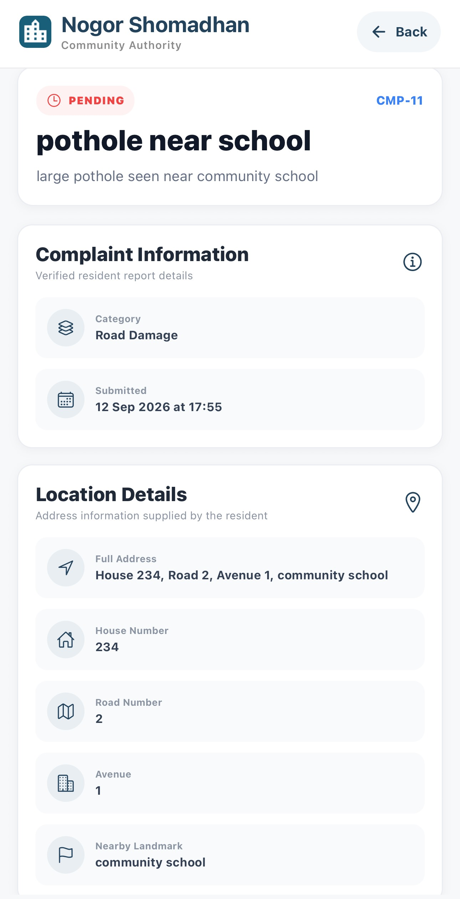
15
PHASE 4 · AUTHORITY STARTS THE WORK
Authority Opens the Complaint
Authority
1
2
3
The dashboard shows complaint counts and a notification badge.
The notification names the complaint that is ready for authority action.
Open the complaint to check its category, submission time, and location.
Nogor Shomadhan · User Manual
15 / 27

Slide 16
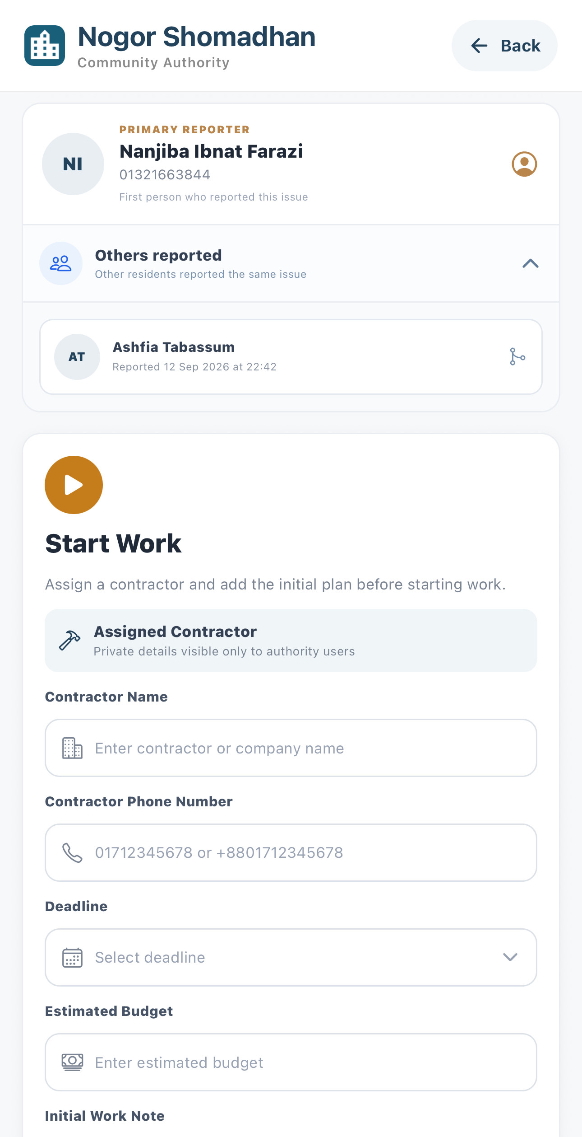
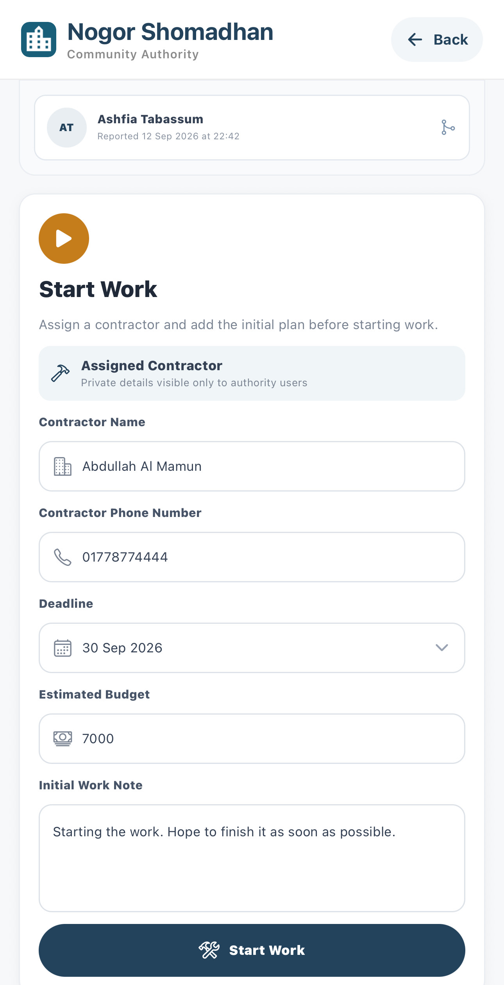
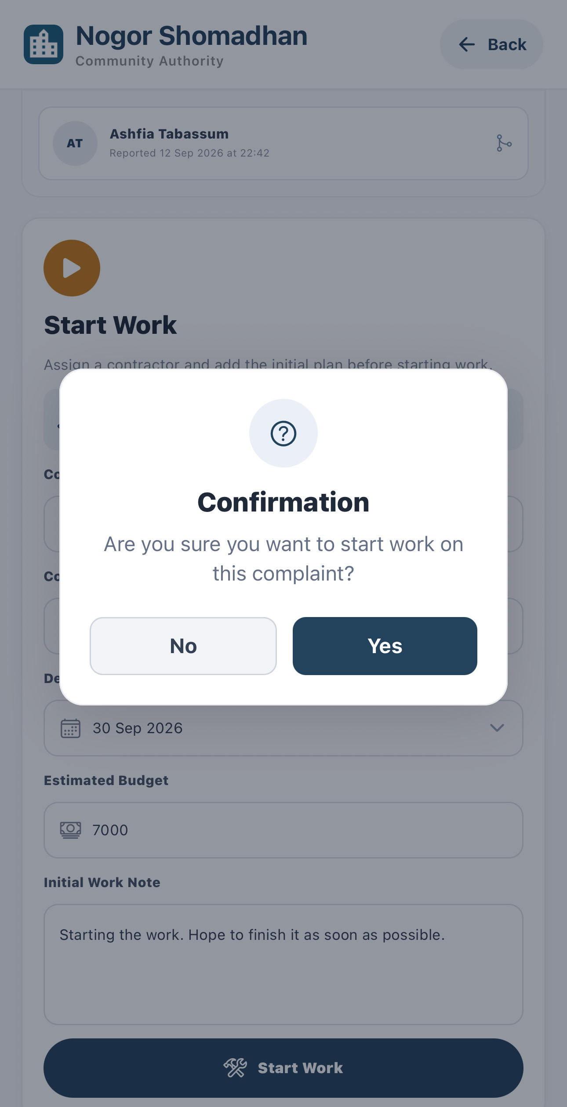
16
PHASE 4 · AUTHORITY STARTS THE WORK
Assign a Contractor and Start Work
Authority
4
5
6
See the primary reporter and the other residents who reported the same issue.
Enter the contractor, phone, deadline, budget, and an initial work note.
Confirm the prompt to start work on this complaint.
Nogor Shomadhan · User Manual
16 / 27

Slide 17
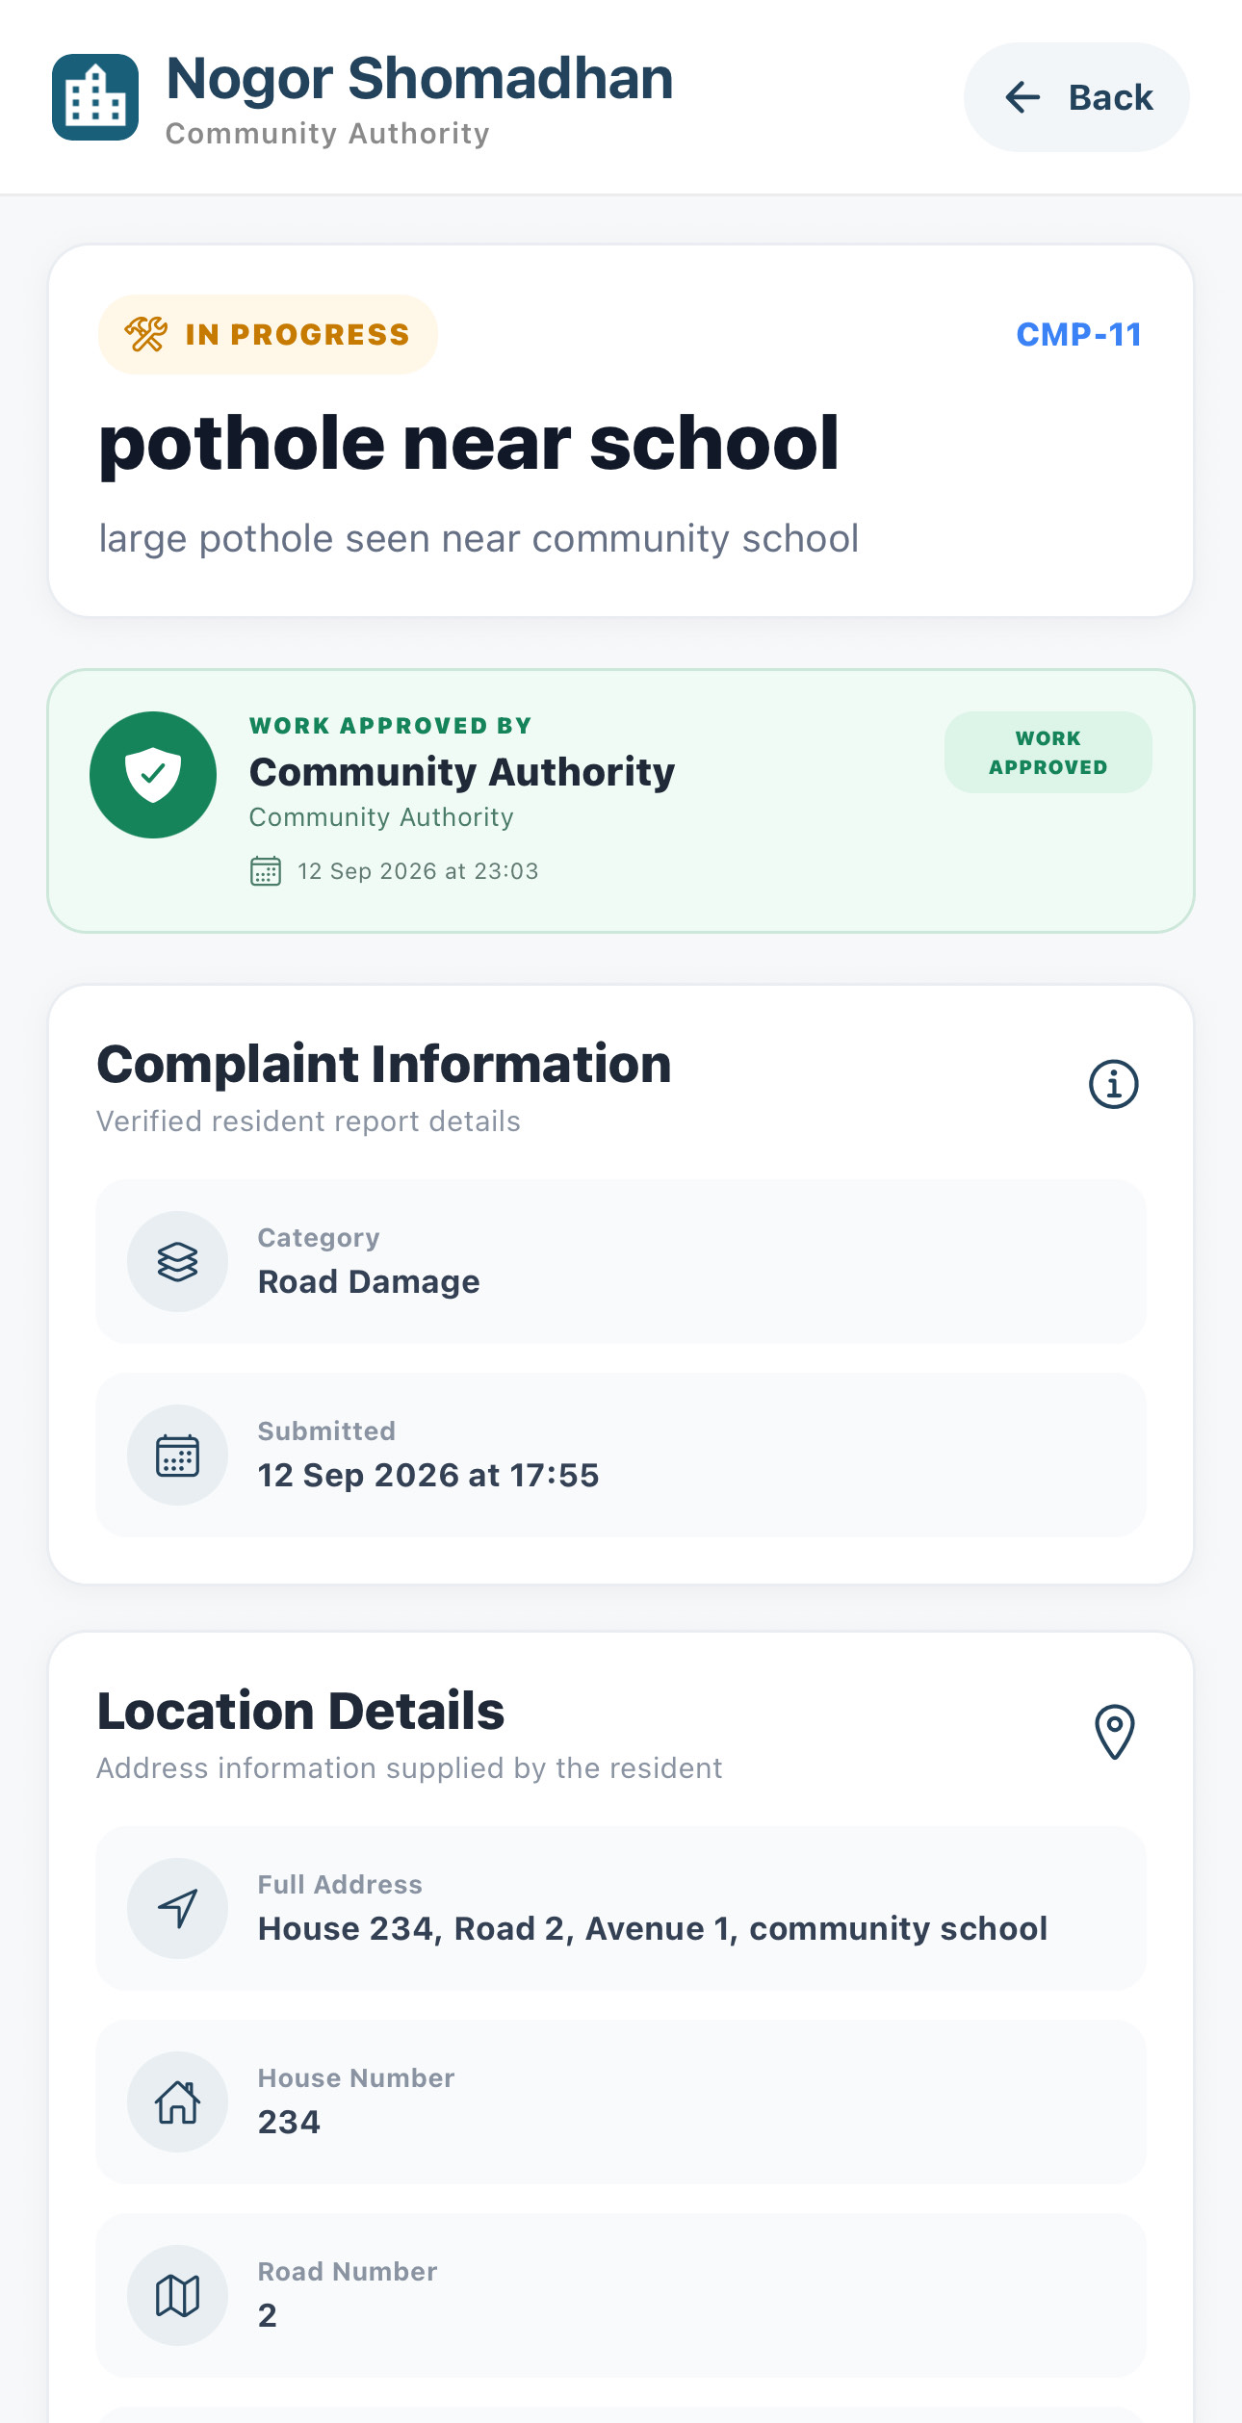
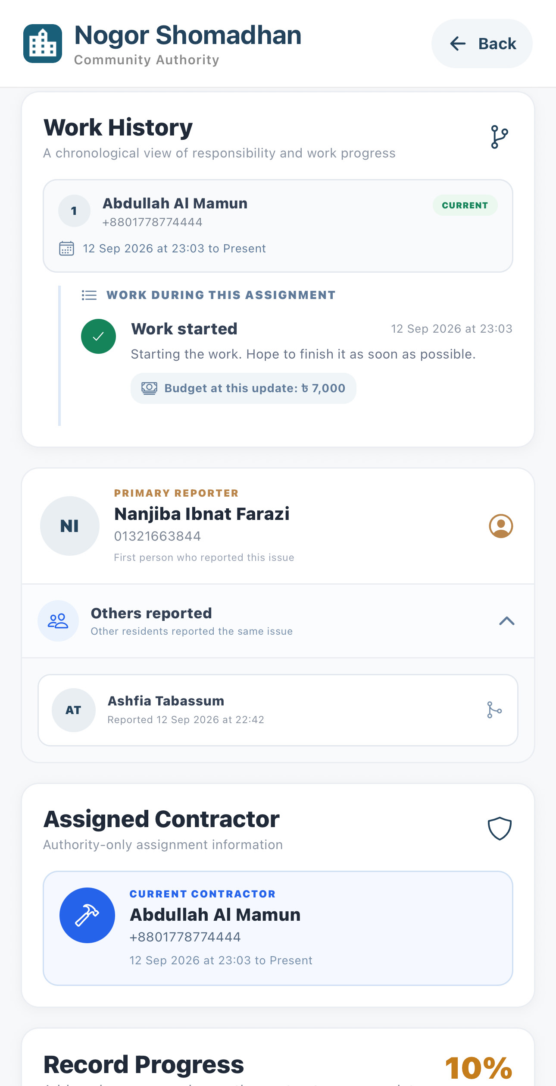
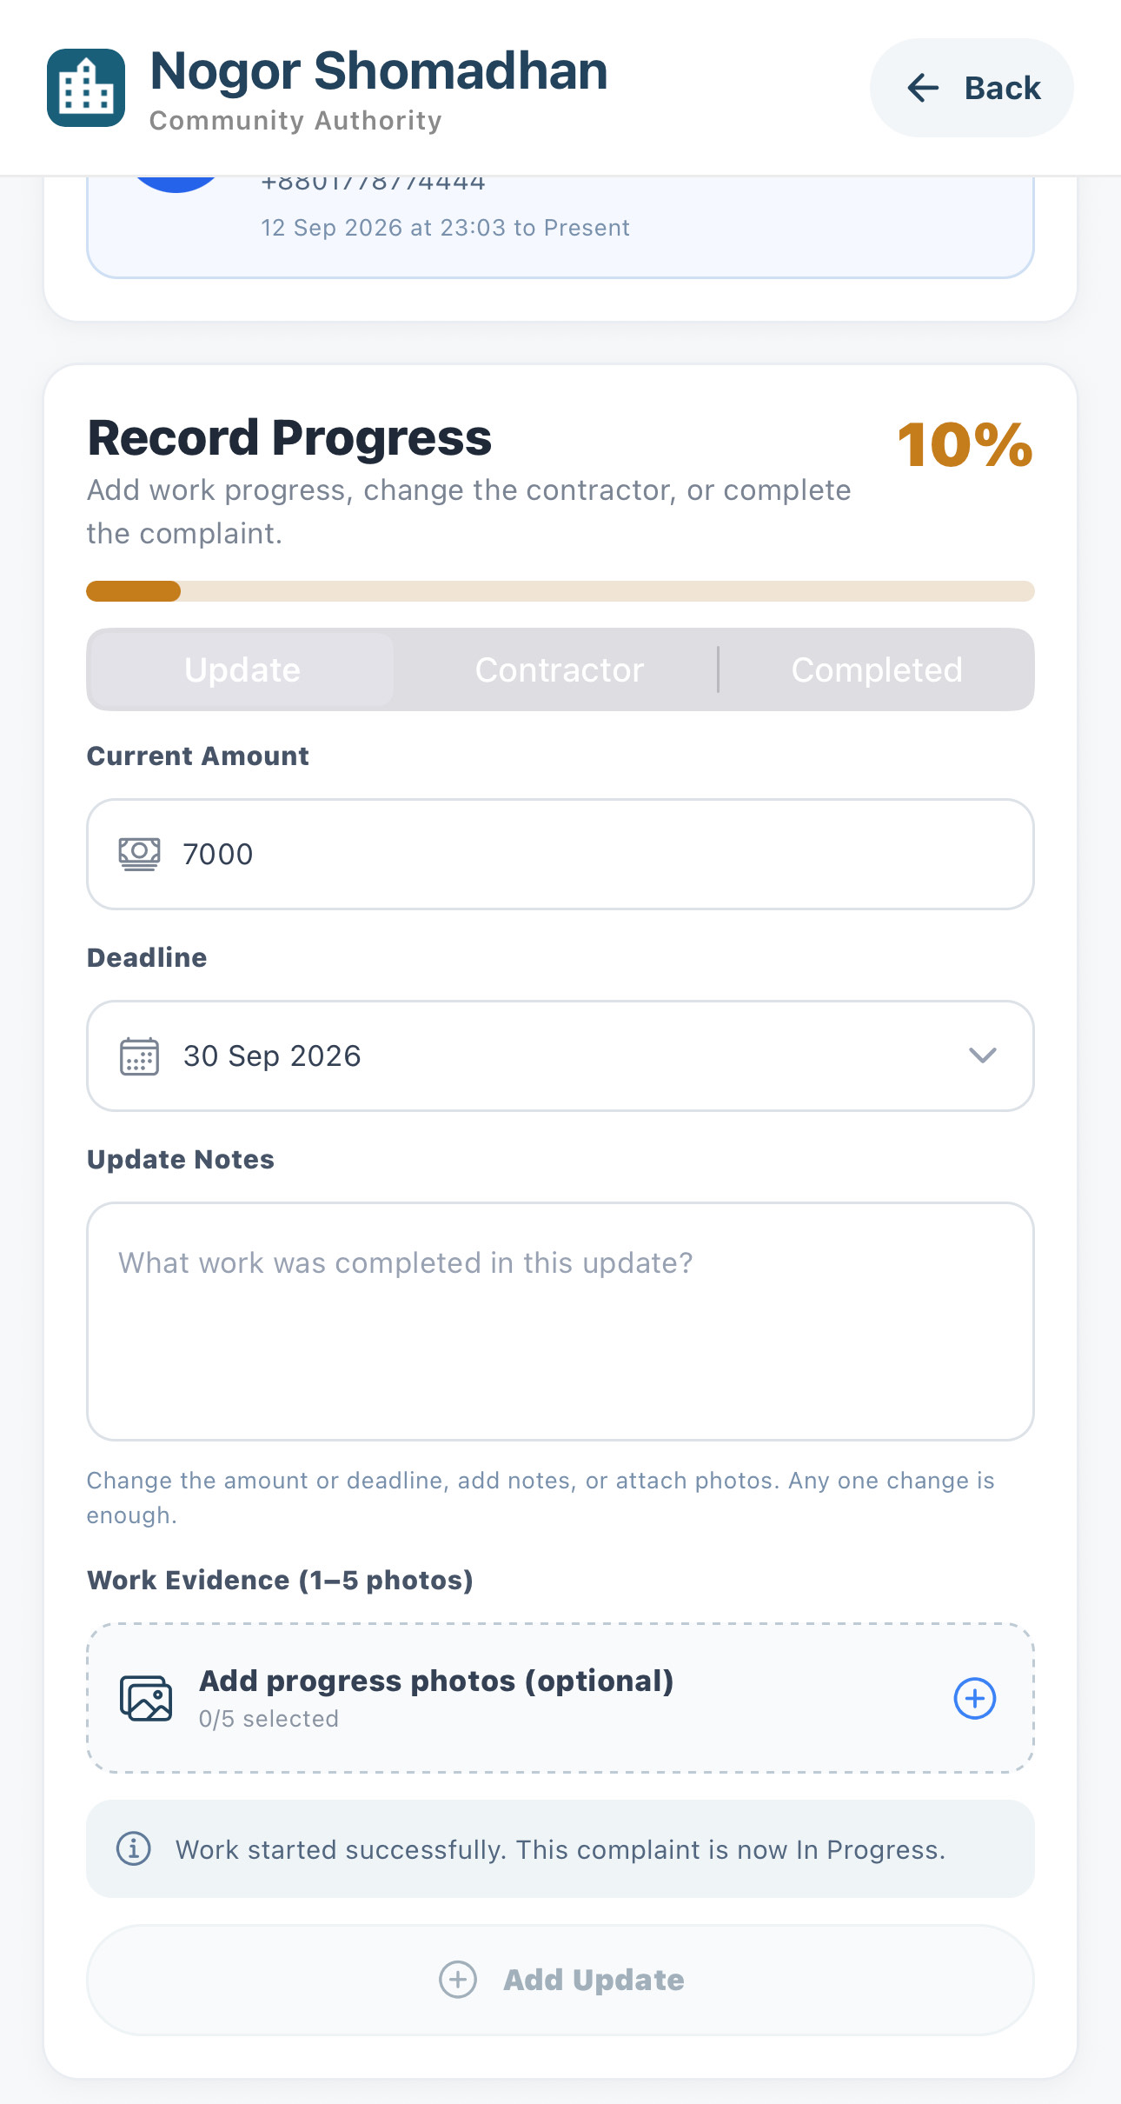
17
PHASE 4 · AUTHORITY STARTS THE WORK
The Complaint Moves to In Progress
Authority
7
8
9
The status changes from Pending to In Progress and approval is recorded.
Work history records the assignment, the first note, and the budget.
The progress panel confirms the complaint is now In Progress.
Nogor Shomadhan · User Manual
17 / 27

Slide 18
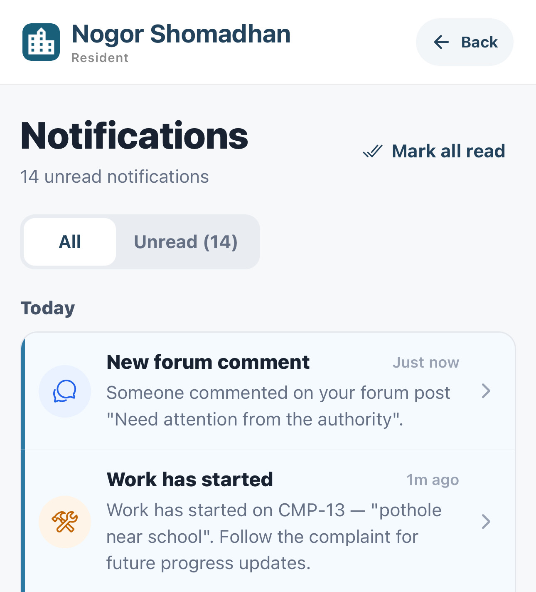
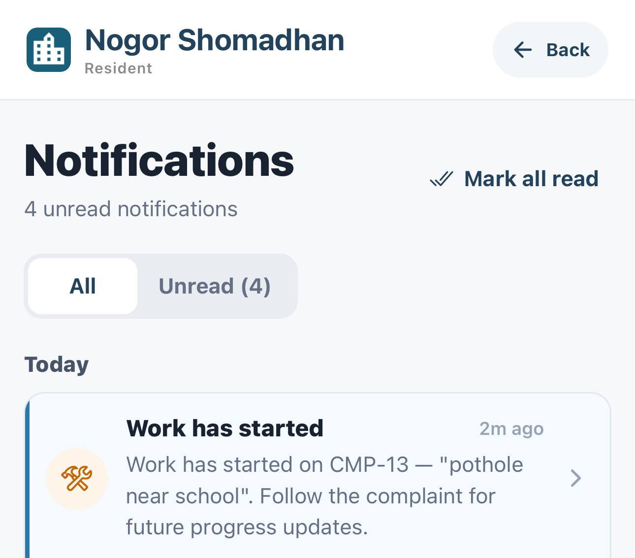
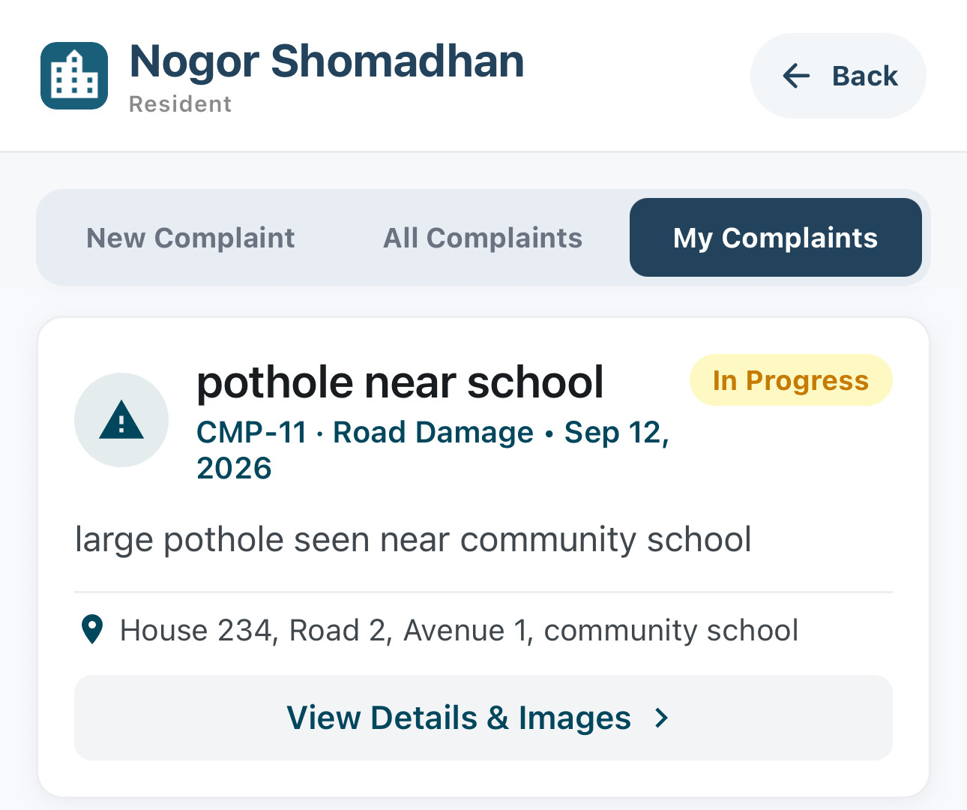
18
PHASE 4 · AUTHORITY STARTS THE WORK
Residents See the Progress Update
Resident
ORIGINAL REPORTER
DUPLICATE REPORTER
IN MY COMPLAINTS
10
11
12
The resident who reported the issue is notified that work has started.
The resident whose duplicate was linked receives the same update.
My Complaints shows the complaint as In Progress.
Nogor Shomadhan · User Manual
18 / 27

Slide 19
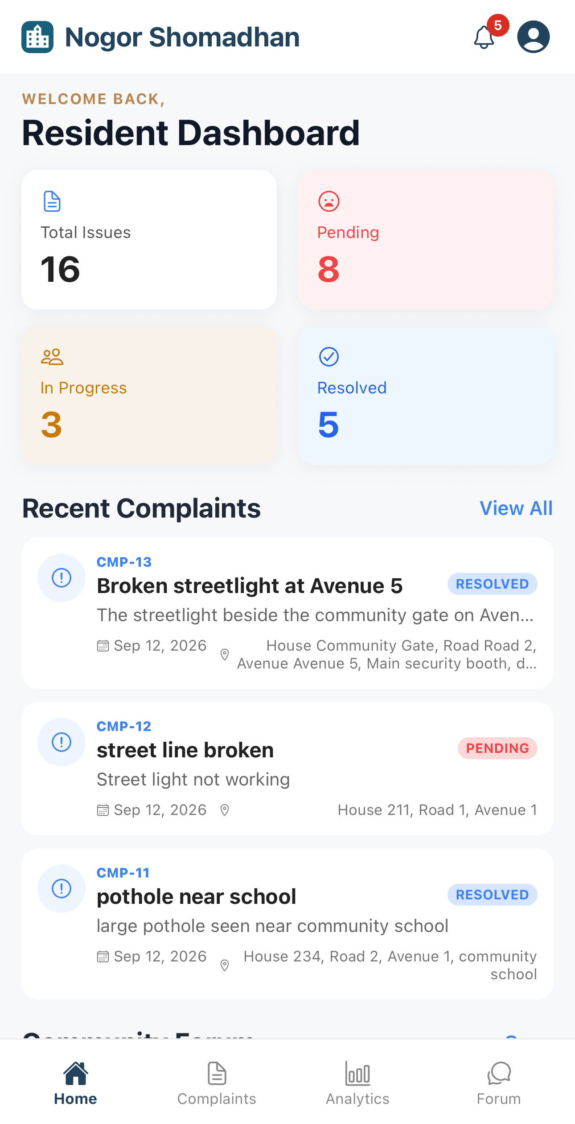
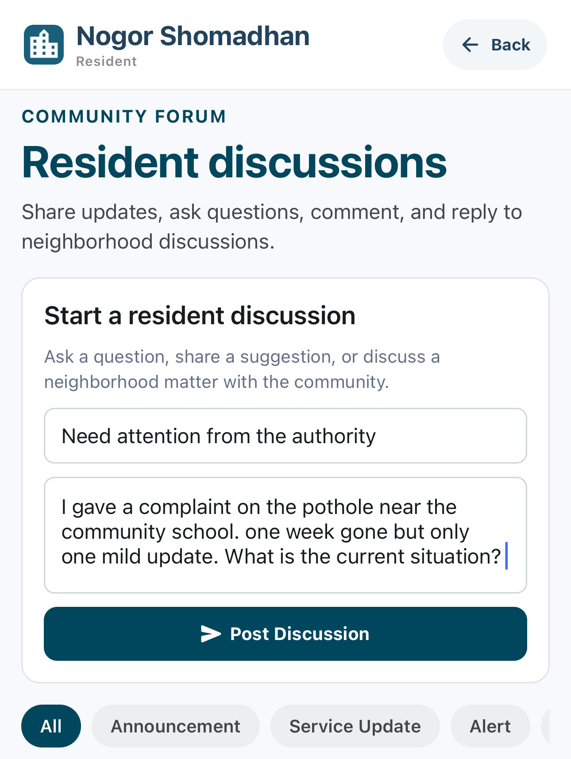
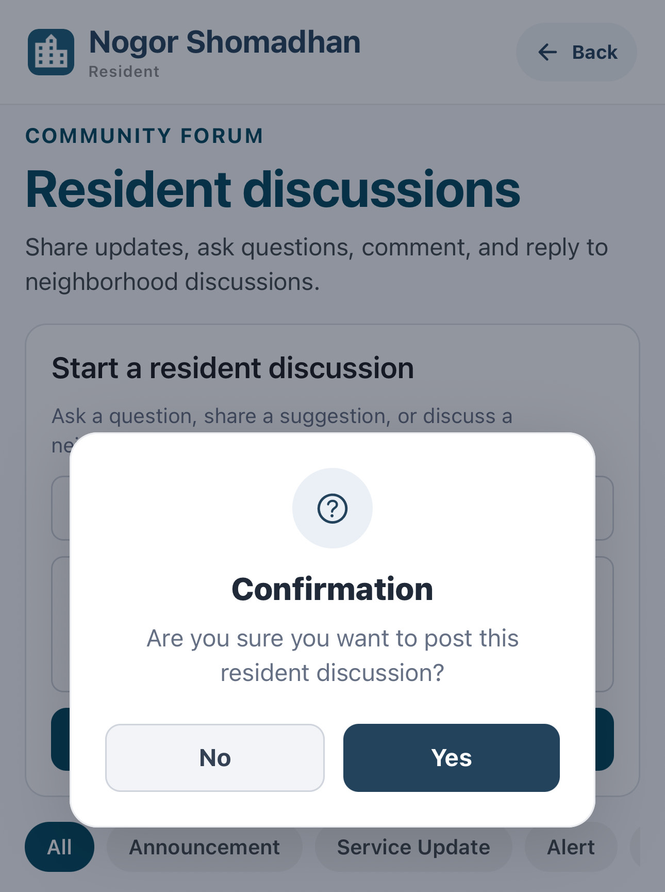
19
PHASE 5 · COMMUNITY FORUM DISCUSSION
Resident Starts a Forum Discussion
Resident
1
2
3
Open Forum from the resident dashboard.
Write a title, describe the issue, and post the discussion.
Confirm the prompt to publish the post to the community.
Nogor Shomadhan · User Manual
19 / 27

Slide 20
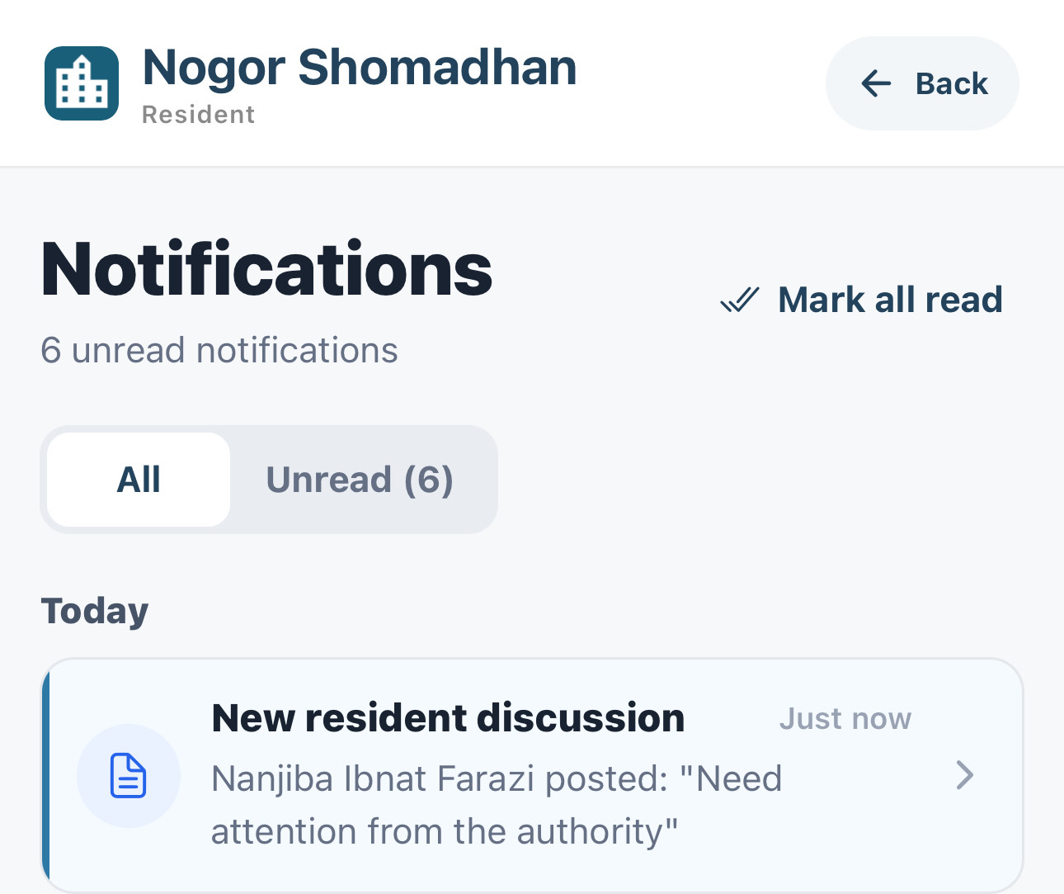
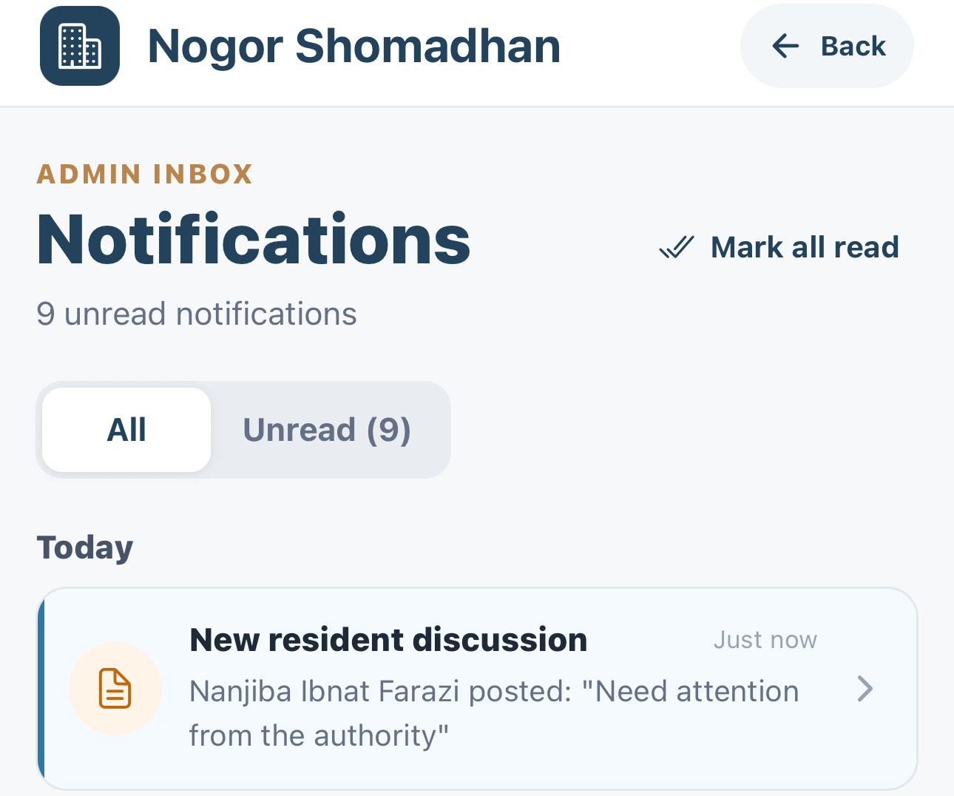

20
PHASE 5 · COMMUNITY FORUM DISCUSSION
Resident
Admin
Authority
Everyone Is Notified
RESIDENT
ADMIN
COMMUNITY AUTHORITY
4
5
5
Other residents are notified that a new discussion was posted.
The admin inbox receives the same discussion notification.
The community authority is notified in its own inbox.
Nogor Shomadhan · User Manual
20 / 27

Slide 21


21
PHASE 5 · COMMUNITY FORUM DISCUSSION
Open the Post and Discuss
Authority
Resident
AUTHORITY OPENS THE POST
RESIDENT
6
7
EVERYONE REPLIES IN ONE THREAD
Residents, the admin, and the community authority all answer in the same discussion. Official replies are badged so residents can tell them apart.
WHO TOOK PART
Residents — follow-up questions
Admin — progress replies
Authority — work updates
Selecting the notification opens the discussion directly, ready to reply.
Each new comment is sent to the other participants as a notification.
Nogor Shomadhan · User Manual
21 / 27

Slide 22



22
PHASE 6 · RESOLUTION AND RESIDENT FEEDBACK
Authority Updates the Work
Authority
Resident
1
2
3
Open Record Progress to change the amount, deadline, or contractor.
Work history records the contractor change and the new deadline.
The resident is notified that the deadline and progress changed.
Nogor Shomadhan · User Manual
22 / 27

Slide 23



23
PHASE 6 · RESOLUTION AND RESIDENT FEEDBACK
Authority Resolves the Complaint
Authority
4
5
6
Upload the final completion photo and the completion note.
Confirm the prompt to resolve the complaint.
The status changes to Resolved and the approval is recorded.
Nogor Shomadhan · User Manual
23 / 27

Slide 24



24
PHASE 6 · RESOLUTION AND RESIDENT FEEDBACK
Residents Give Feedback
Resident
8
9
7
The resident is notified that the complaint is resolved and can rate it.
Choose a star rating and write a short comment.
Confirm the prompt to submit the feedback.
Nogor Shomadhan · User Manual
24 / 27

Slide 25



25
PHASE 6 · RESOLUTION AND RESIDENT FEEDBACK
Feedback Is Public and Answered
Resident
Authority
10
12
11
The rating and comment appear on the complaint for everyone to see.
The authority is notified that a resident left a rating.
The authority replies to the feedback in the community discussion.
Nogor Shomadhan · User Manual
25 / 27

Slide 26



26
ADDITIONAL FEATURES · ANALYTICS AND FORUM TOOLS
Resident
Admin
Authority
Analytics and Reporting
1
2
3
Complaint volume, status, resolution rate, and response time at a glance.
Breakdowns by category and area, plus deadline and response performance.
Download Report PDF exports the selected period as a shareable file.
Nogor Shomadhan · User Manual
26 / 27

Slide 27


27
ADDITIONAL FEATURES · ANALYTICS AND FORUM TOOLS
Forum Announcements and Events
Admin
4
5
OFFICIAL POST TYPES
ANNOUNCEMENT
Planned notices, schedules, and community events
SERVICE UPDATE
Progress or changes to community services
ALERT
Urgent, time-sensitive information
Residents can filter the forum by type.
Create an event, mark the dates, and post it to the community.
Write an official post and choose its message type before publishing.
Nogor Shomadhan · User Manual
27 / 27

